Slide 1


IN THE NAME OF GOD
laser spectroscopy
Dr.ghalambor
PART 2 / From pages 80 to 95
Mahin Asakereh
9848805
1399/1/27

Slide 2
Contents
Homogeneous and Inhomogeneous Line Broadening…………………………………………….…….3
Saturation and Power Broadening………………….……….7
Saturation of Level Population by Optical Pumping…………………………………………………..…8
Saturation Broadening of Homogeneous Line Proﬁles……………………………………………………..13
Power Broadening……………………………………...…..17

Slide 3
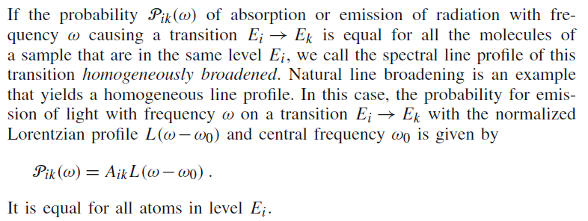
3.5 Homogeneous and Inhomogeneous Line Broadening
تکمیلی

Slide 4
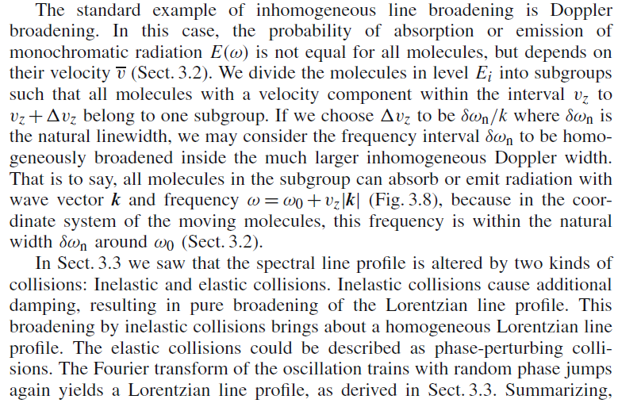
تکمیلی

Slide 5
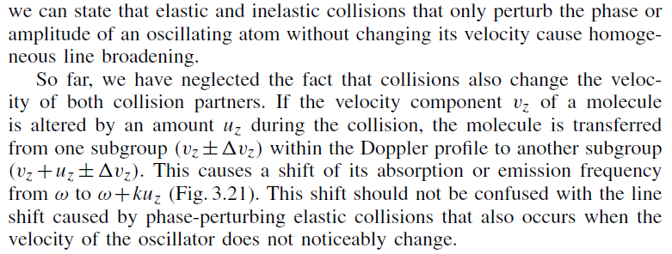
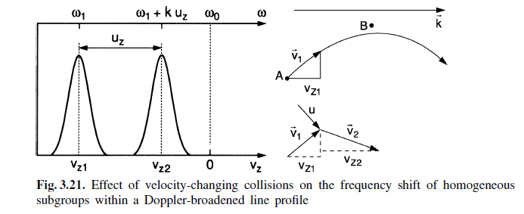

Slide 6
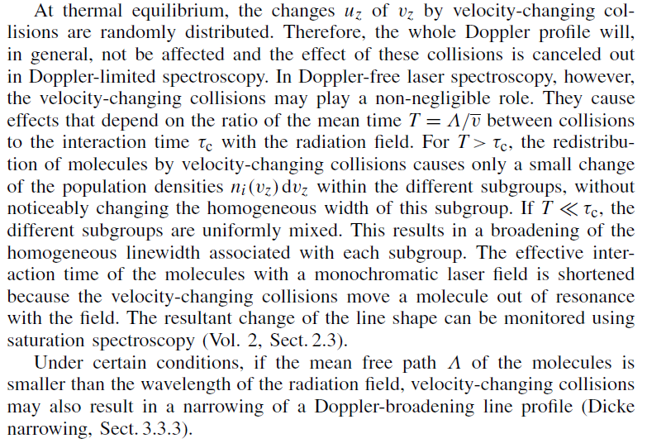
تکمیلی

Slide 7
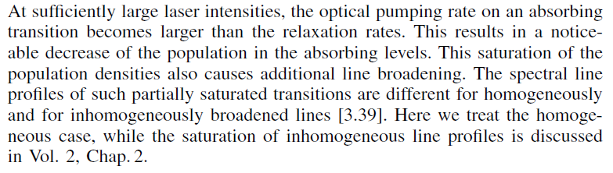
3.6 Saturation and Power Broadening
تکمیلی

Slide 8
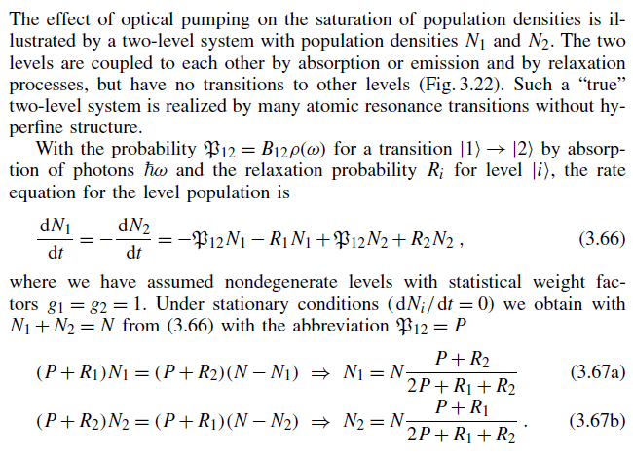
3.6.1 Saturation of Level Population by Optical Pumping
تکمیلی

Slide 9
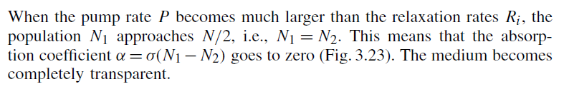
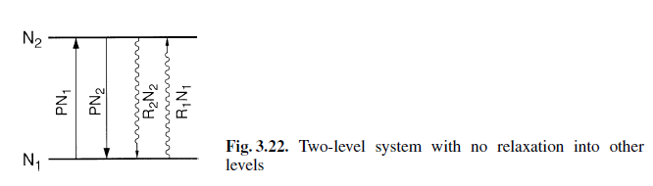

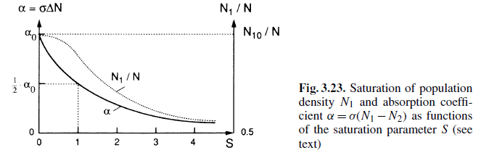
تکمیلی

Slide 10
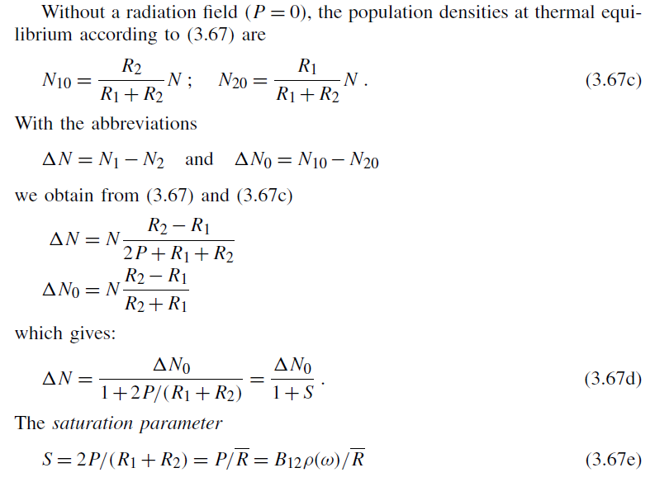
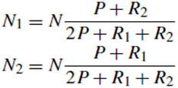
تکمیلی

Slide 11
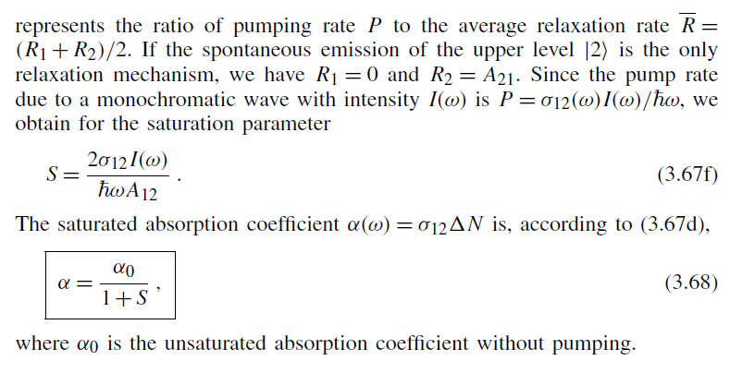
تکمیلی

Slide 12
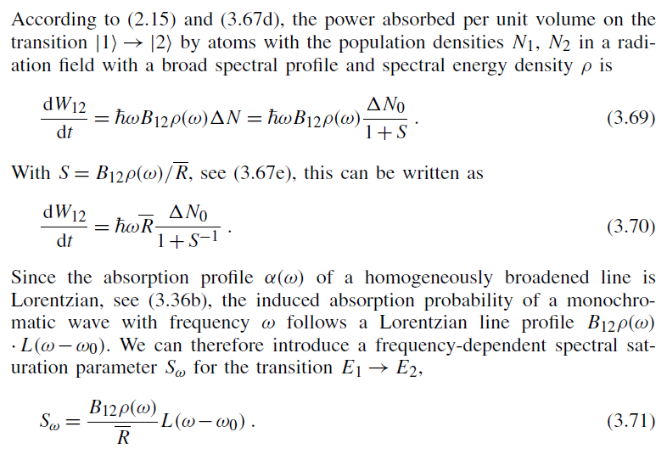
3.6.2 Saturation Broadening of Homogeneous Line Proﬁles
تکمیلی

Slide 13
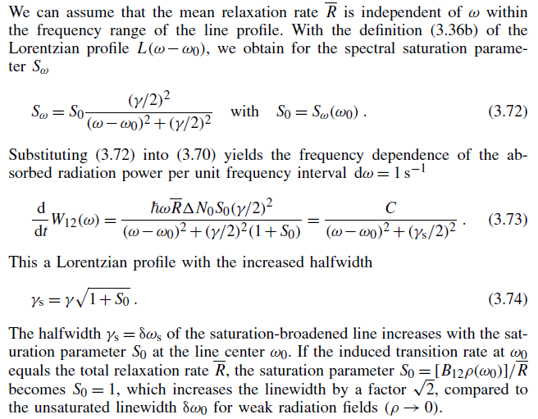
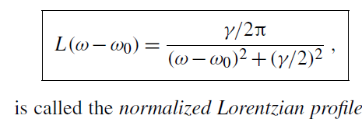


تکمیلی

Slide 14
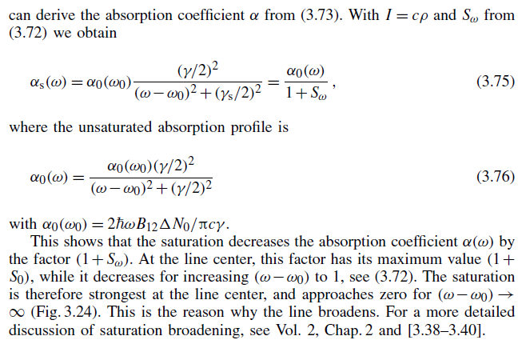
تکمیلی

Slide 15
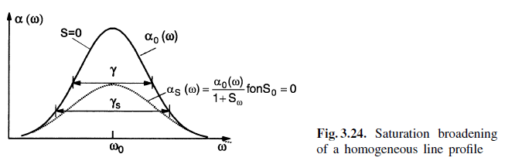
تکمیلی

Slide 16
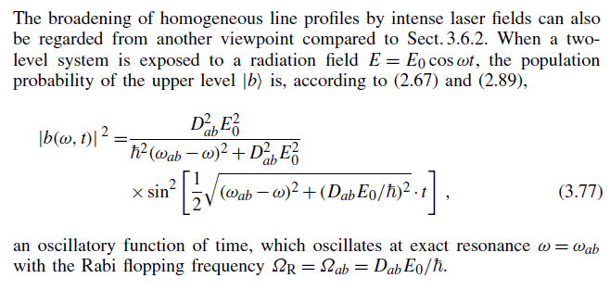
3.6.3 Power Broadening
تکمیلی

Slide 17
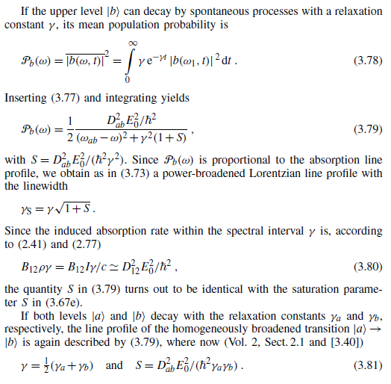

تکمیلی

Slide 18
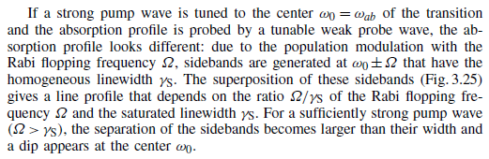
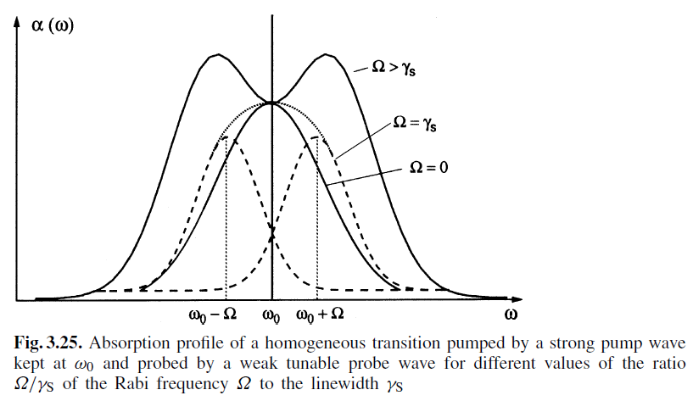
تکمیلی

Slide 19
THE END

