Slide 1
IN THE NAME OF GOD laser spectroscopy Dr.ghalambor PART 1/ From pages 80 to 95 Mahin Asakereh 9848805 1399/1/27
تکمیلی

Slide 2
Contents
Relations Between Interaction Potential, Line Broadening, and Shifts………………………………………………….3
Collisional Narrowing of Lines…………………………...10
Transit-Time Broadening…………………………………13
تکمیلی

Slide 3
3.3.2 Relations Between Interaction Potential, Line Broadening, and Shifts
تکمیلی

Slide 4
The line broadening comes from two contributions:
(a) The phase shift, due to the frequency shift of the
oscillator during the collision
(b)the quenching collisions which shorten the effective
lifetime of the upper level of A.
تکمیلی

Slide 5
تکمیلی

Slide 6
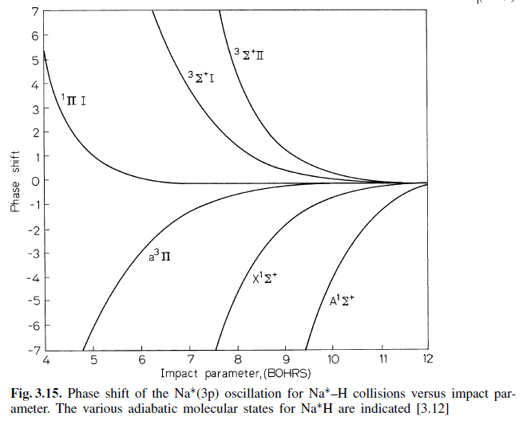
تکمیلی

Slide 7
تکمیلی

Slide 8
تکمیلی

Slide 9
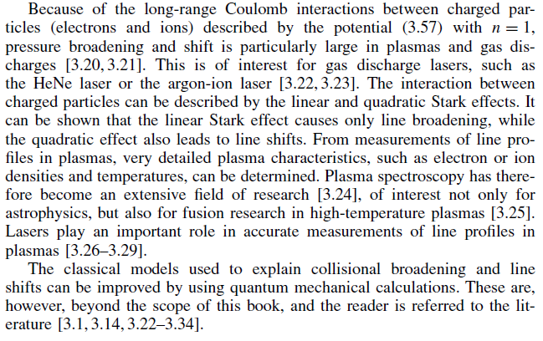
تکمیلی

Slide 10
تـــــــــــــوجـــــــــــــــــه

