Slide 1

Vacuum Pumping
Gas removal
Section: Transfer Pumps
Turbo Molecular Pumps

Slide 2
Pumping systems_________________________
• The selection of pump type and capacity depends on the system
requirements and the available budget.
• The pumping speed, S, is the volumetric flow through the pump
intake port: S= dV/ dt. (Units- L/s, m³/h, cm³/s).
• A vacuum pump is characterised by its throughput, Q, as
product of the S and the inlet pressure of the pump, P:
Q = S P (1)
• Throughput=pumping capacity= quantity of gas moved by the
pump over a unit of time (Units - mbar⋅L/s)
Material and Energy Research Centre (MERC)

Slide 3
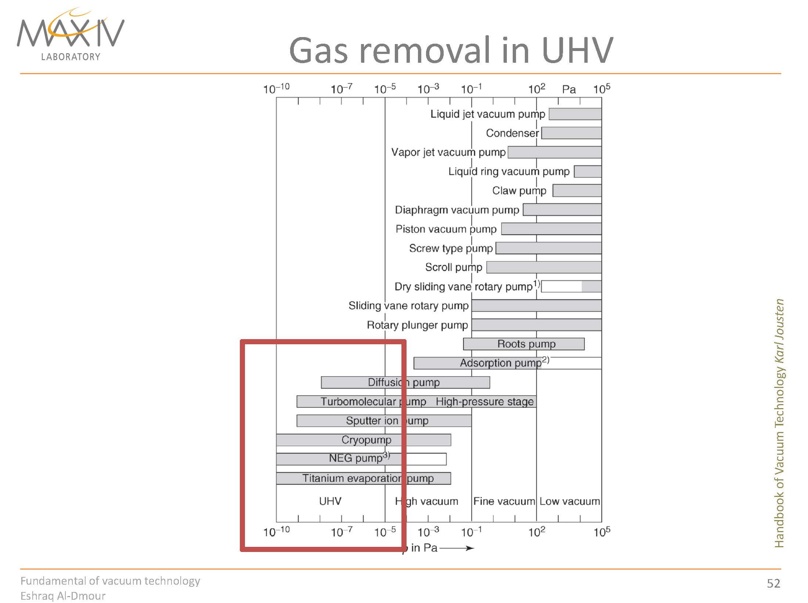

Slide 4
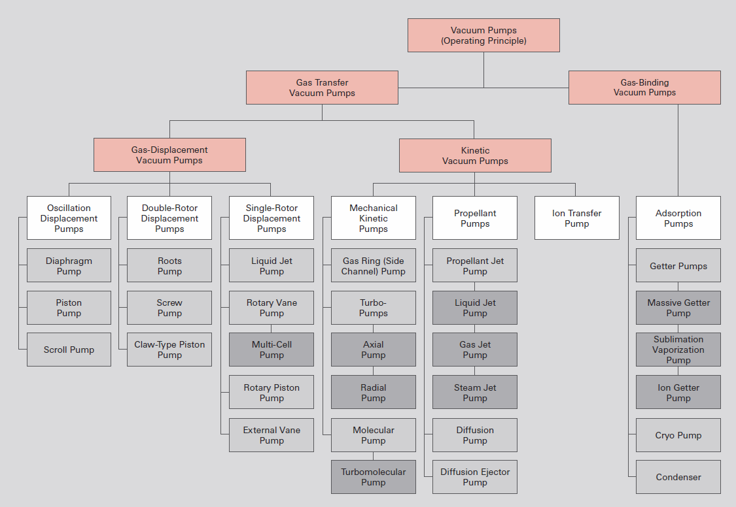
Pumping Technology
Overview of vacuum pumps

Slide 5
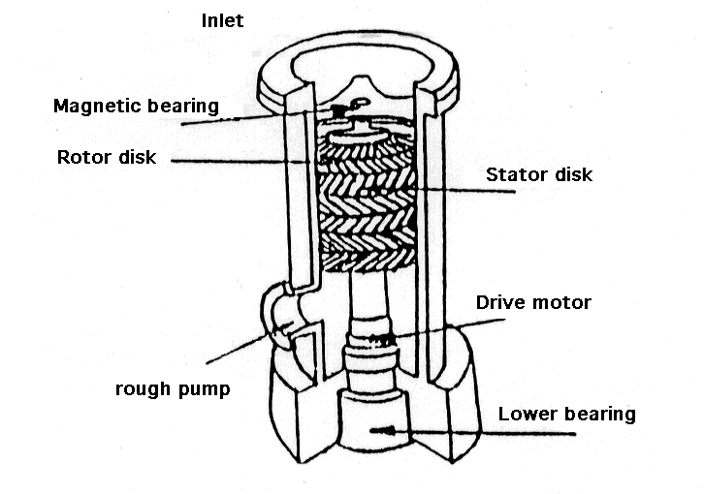
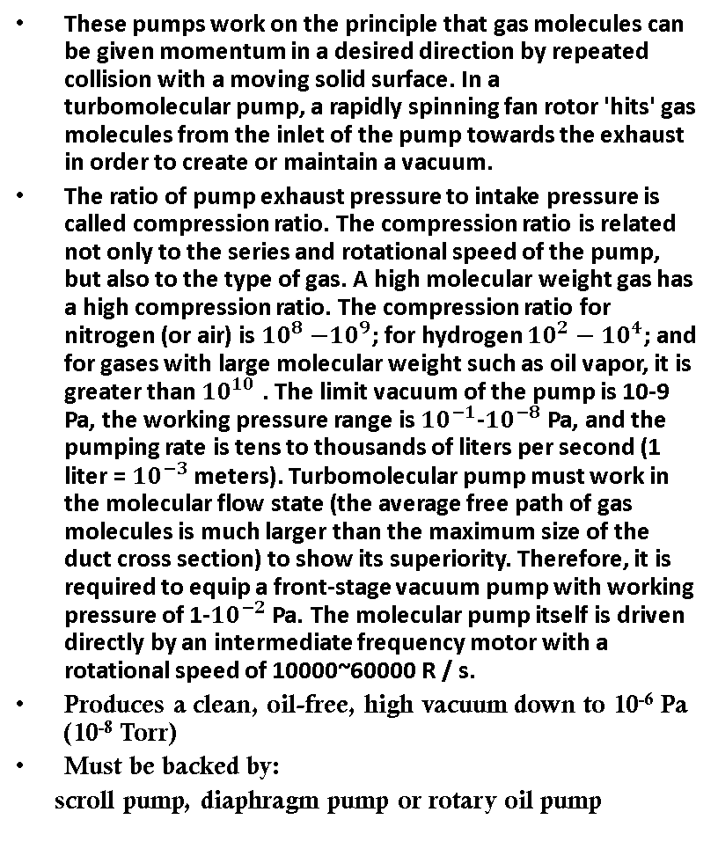
پمپ توربو مولکولار
These pumps work on the principle that gas molecules can be given momentum in a desired direction by repeated collision with a moving solid surface. In a turbomolecular pump, a rapidly spinning fan rotor 'hits' gas molecules from the inlet of the pump towards the exhaust in order to create or maintain a vacuum.
The ratio of pump exhaust pressure to intake pressure is called compression ratio. The compression ratio is related not only to the series and rotational speed of the pump, but also to the type of gas. A high molecular weight gas has a high compression ratio. The compression ratio for nitrogen (or air) is ${10}^{8}{−10}^{9}$; for hydrogen ${10}^{2}−{10}^{4}$; and for gases with large molecular weight such as oil vapor, it is greater than ${10}^{10}$ . The limit vacuum of the pump is 10-9 Pa, the working pressure range is ${10}^{−1}$-${10}^{−8}$ Pa, and the pumping rate is tens to thousands of liters per second (1 liter = ${10}^{−3}$ meters). Turbomolecular pump must work in the molecular flow state (the average free path of gas molecules is much larger than the maximum size of the duct cross section) to show its superiority. Therefore, it is required to equip a front-stage vacuum pump with working pressure of 1-${10}^{−2}$ Pa. The molecular pump itself is driven directly by an intermediate frequency motor with a rotational speed of 10000~60000 R / s.
Produces a clean, oil-free, high vacuum down to 10⁻⁶ Pa (10⁻⁸ Torr)
Must be backed by:
scroll pump, diaphragm pump or rotary oil pump

Slide 6
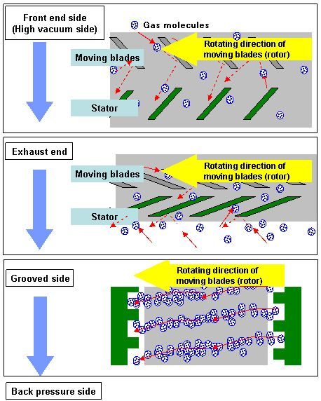
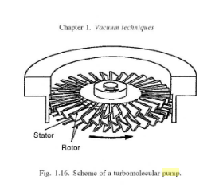
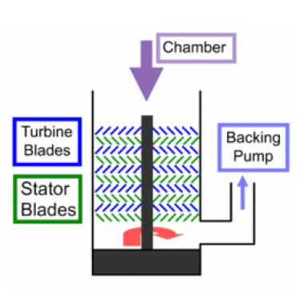
4
2
1
3

Slide 7
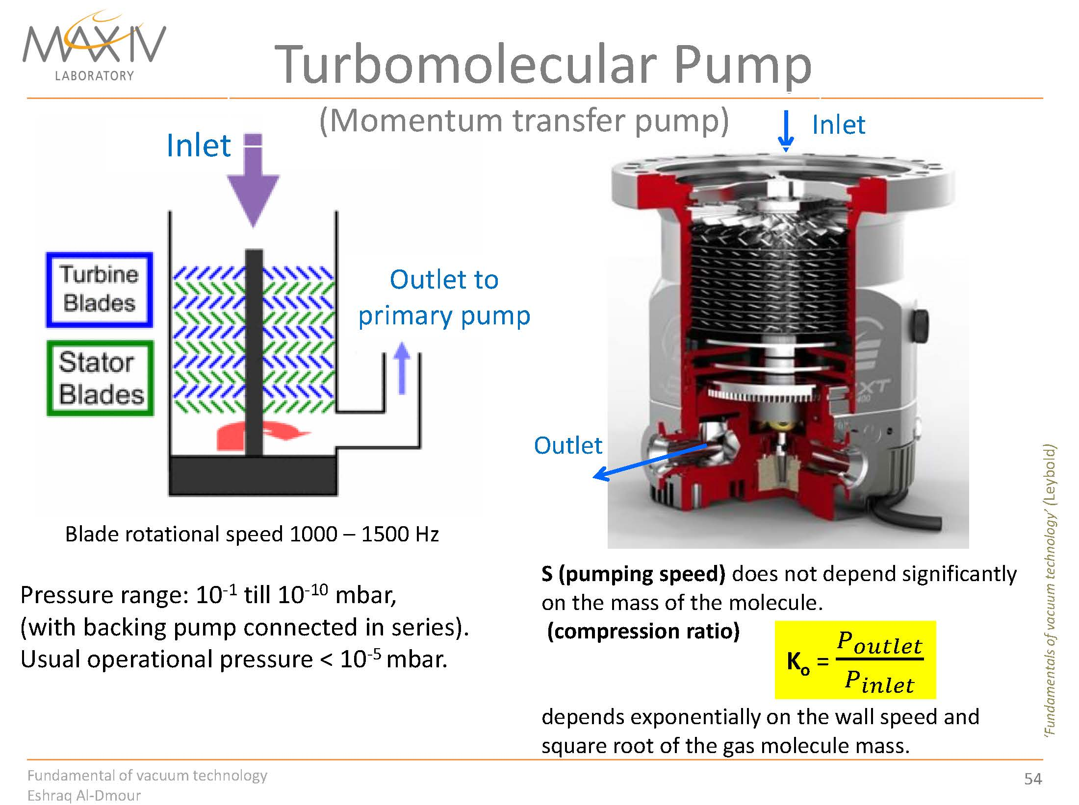

Slide 8
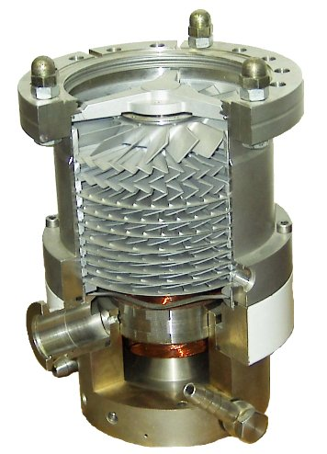
Turbomolecular Pumps
Similar in design to a jet engine. Alternating rotor and stator blade assemblies turn at 20,000-90,000 rpm to force out molecules. Requires a region of low or medium vacuum behind and in front of pump.
Pfeiffer Vacuum GmbH

Slide 9
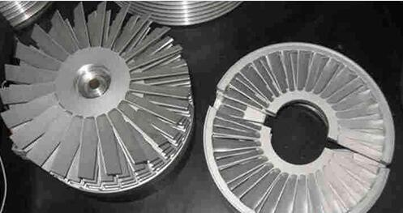
تیغه های پمپ: روتور و استاتور

Slide 10
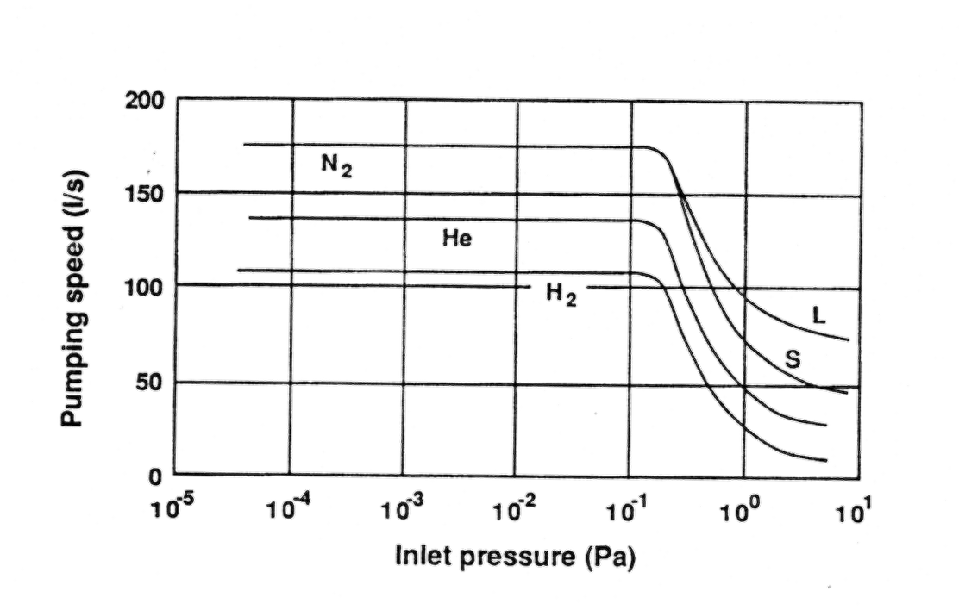
Turbo pump performance
Turbo pumps can start even at atmospheric pressure (although they labor) and they can go down to 10⁻⁸ T
It is best to pre-pump the system with a clean backing system
TMP do not pump all gases with same efficiency - large molecules are pumped faster than smaller molecules
1 milliT = 0.13Pa = 1 μmHg
Turbo pump performance

Slide 11
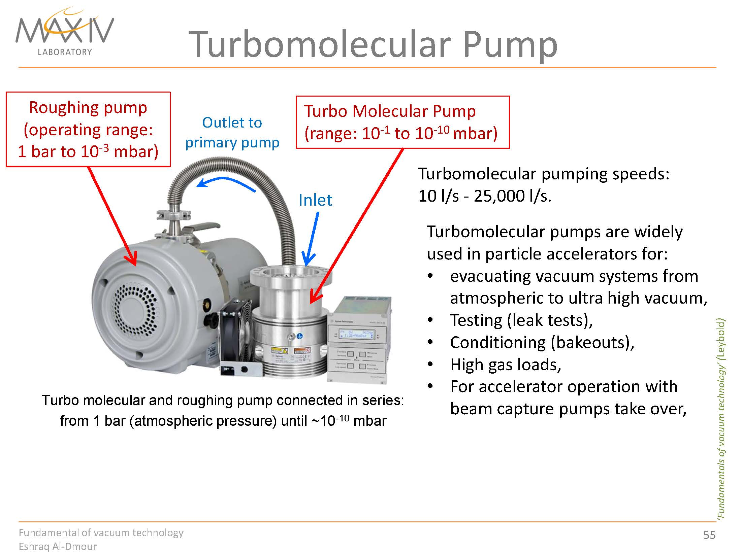

Slide 12
پایان

