Slide 1
Vacuum Pumping
Gas removal
Section: Transfer Pumps

Slide 2
How does one achieve vacuum?
Pumping – Two types
Transfer – relies on moving molecules from low to high pressure regions
Trapping – makes use of chemistry to trap or bury gas particles

Slide 4
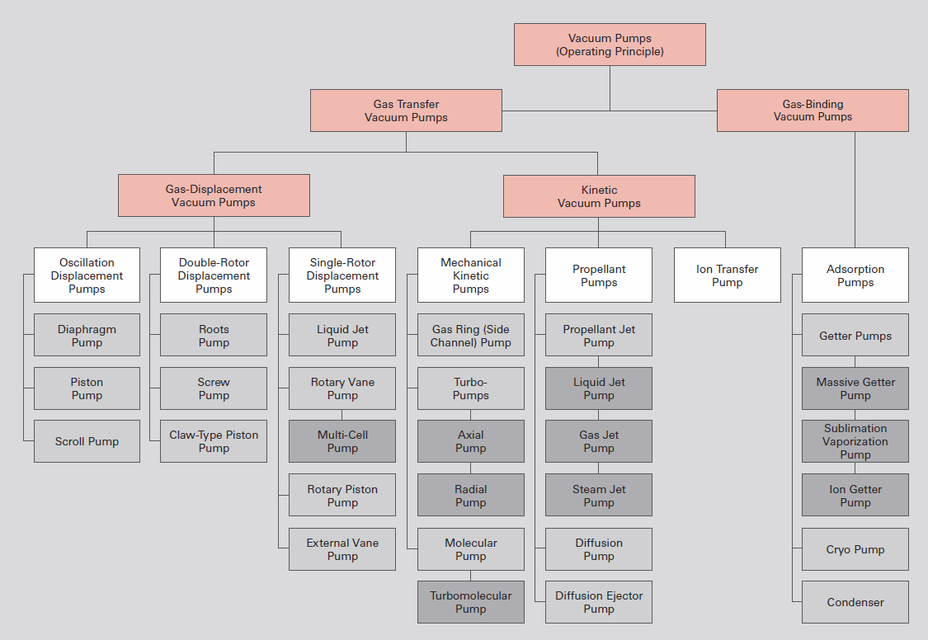
Pumping Technology
Overview of vacuum pumps

Slide 6
Levels of vacuum
Rough vacuum
– 10⁻² mBar->1Atm
– a simple single or double stage rotary pump.
• High vacuum
– 10⁻⁶ mBar->10⁻² mBar
– Require a compound pumping system with a
high vacuum pump backed by a rotary pump.
– Sealing system on chambers etc. usually
rubber or viscoelastomer (viton) o-rings.
• UHV etc.
– 10⁻¹⁰ mBar->10⁻⁶ mBar
– Similar pumping schemes to high vacuum
– Requires a leak-tight system with minimal
outgassing.
– Can only reach<10⁻⁸ mBar after lengthy
pumping and baking.
Custom UHV sputter system.
• All-metal seals
• 12-25 hour pump-down
• Load-lock

Slide 7
Pumping systems_________________________
• The selection of pump type and capacity depends on the system
requirements and the available budget.
• The pumping speed, S, is the volumetric flow through the pump
intake port: S= dV/ dt. (Units- L/s, m³/h, cm³/s).
• A vacuum pump is characterised by its throughput, Q, as
product of the S and the inlet pressure of the pump, P:
Q = S P (1)
• Throughput=pumping capacity= quantity of gas moved by the
pump over a unit of time (Units - mbar⋅L/s)
Material and Energy Research Centre (MERC)

Slide 8
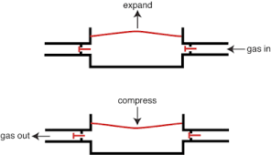
Diaphragm pumpsپمپهای دیافراگمی____
• پمپ های ساده ای هستند که دارای نسبت فشردگی کمی می باشند
از مشخصات بارز آن ها اینست که بدون روغن و عاری از هر گونه آلایندگی می باشند.
Fluoro Mechanic Co.,
Ltd. (Japan)

Slide 9
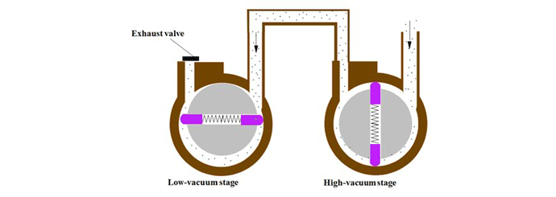
Mechanical pump designs
Roots
Rotary Piston
Rotary Vane
Rotary Vane

Slide 10
Roots vacuum pumpsروت پمپ ها
Roots vacuum pumps, or vacuum boosters, are dry vacuum pumps that are used together with backing pumps in a wide range of applications where large pumping speeds are required. ... Some roots vacuum / booster pumps are equipped with a by-pass valve.

Slide 11
Rotary vane pumpsپمپ های روتاری
The ultimate pressure achievable by the pump is limited by back-leakage through the Duo seal and by the outgassing of the lubricating oil. The outlet pressure can be as high as 1000 mbar (750 Torr) and the inlet as low as .01 mbar (0.0075 Torr), which means the pressure differential across the oil-filled seal is roughly 100,000:1 (1000:0.01). At pressure differentials greater than this, back-leakage across the seal will occur, which represents one of the limiting factors in the ultimate vacuum achieved by rotary vane pumps.
There are four stages of operation in a typical rotary vane pump .
Induction. The first 180° rotation of the rotor induces the gas into the pumping chamber. The volume occupied by the gas increases due to the crescent-shaped space created by the offset-mounted rotor. The gas pressure decreases in proportion to the increase in its volume (Boyle’s law). This draws the gas into the pump and generates the required vacuum.
Isolation. The uppermost vane passes the inlet port, sealing it off from the gas being pumped.
Compression. Further rotation compresses and heats the gas ahead of the lowermost vane, reducing its volume due to the decreasing space between the rotor and stator.
Exhaust. As the lowermost vane continues its rotation, the pressure in front of it increases sufficiently to force the exhaust valve open, discharging the gas at a pressure slightly above atmospheric.

Slide 12
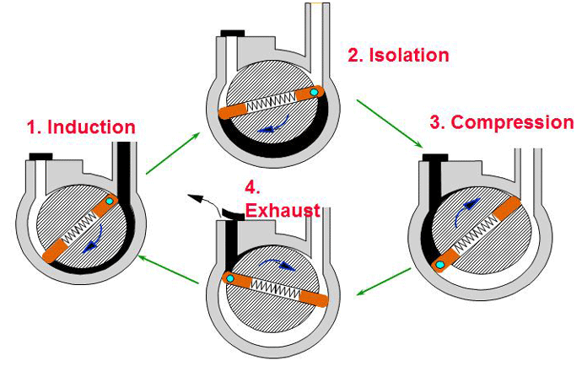
Working principles اصول عملکرد

Slide 13
