Slide 1
Vacuum Pumping
Gas removal
Section: Transfer Pumps

Slide 2

Pumping systems_________________________
• The selection of pump type and capacity depends on the system
requirements and the available budget.
• The pumping speed, S, is the volumetric flow through the pump
intake port: S= dV/ dt. (Units- L/s, m³/h, cm³/s).
• A vacuum pump is characterised by its throughput, Q, as
product of the S and the inlet pressure of the pump, P:
Q = S P (1)
• Throughput=pumping capacity= quantity of gas moved by the
pump over a unit of time (Units - mbar⋅L/s)
Material and Energy Research Centre (MERC)

Slide 3
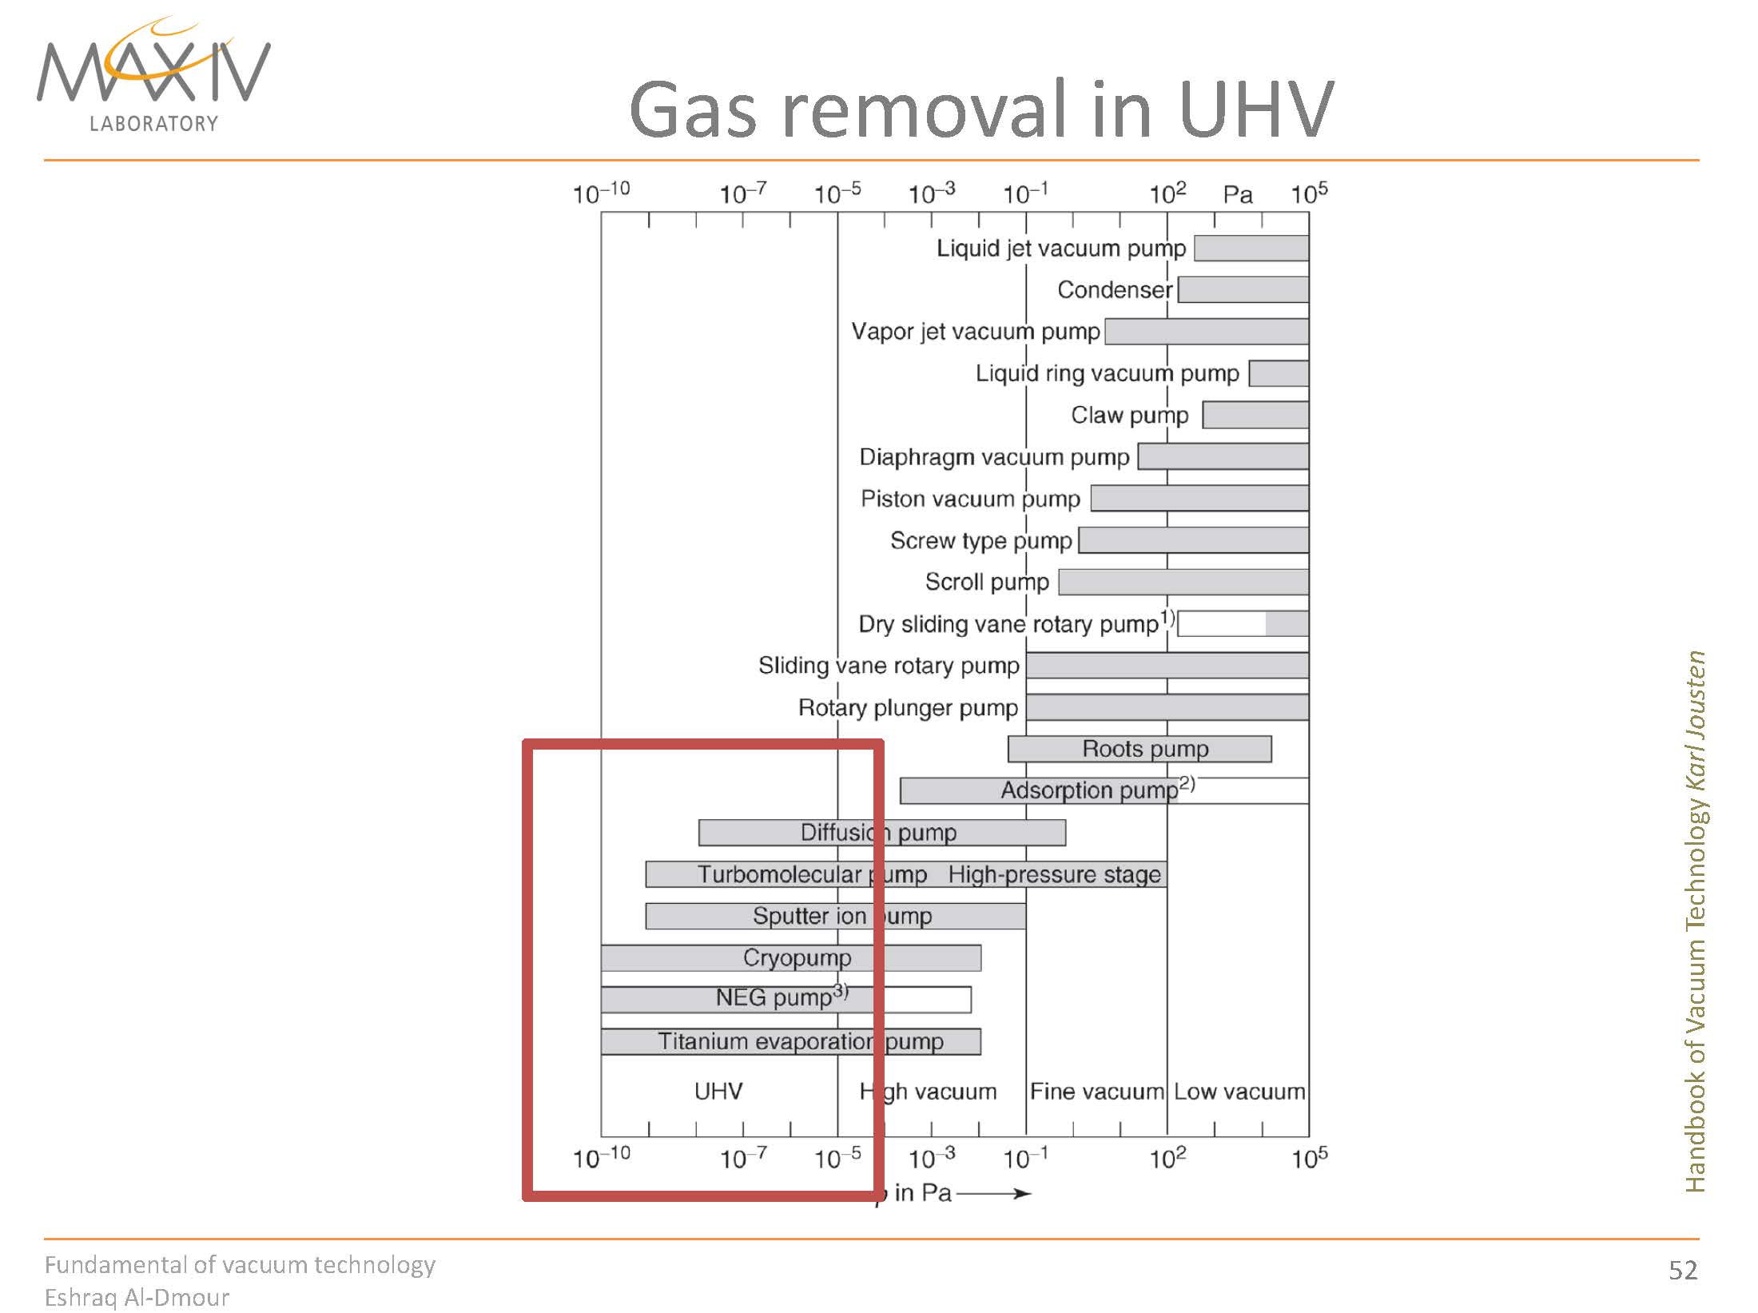

Slide 4
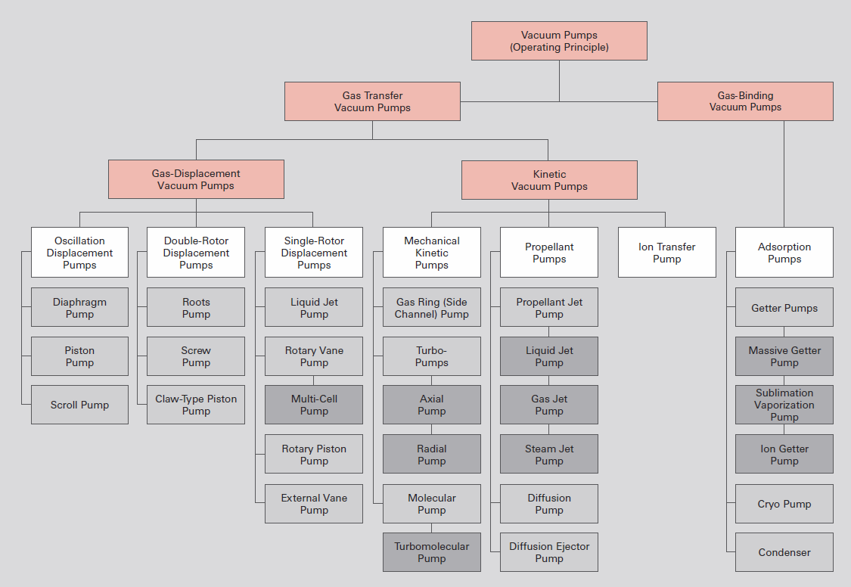
Pumping Technology
Overview of vacuum pumps

Slide 5
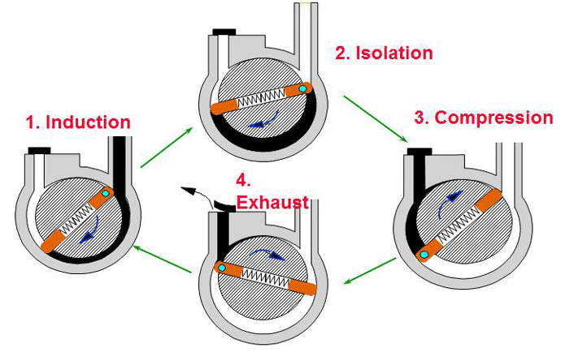
Working principles اصول عملکرد
1
2

Slide 6
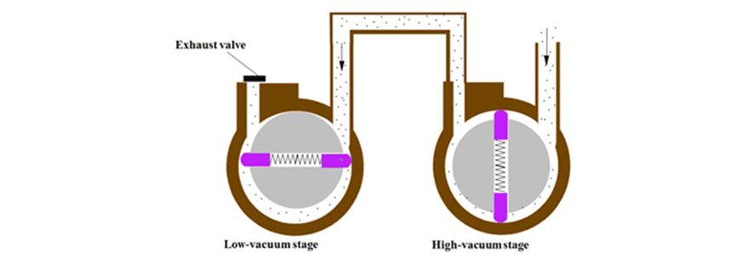
پمپهای دو طبقه

Slide 7
Diffusion Pumps
پمپ های دیفیوژن

Slide 8
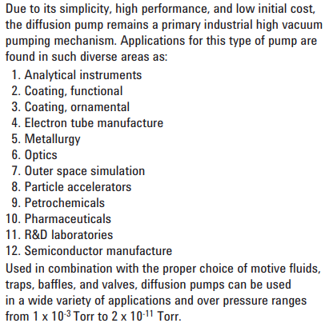
Applications

Slide 9
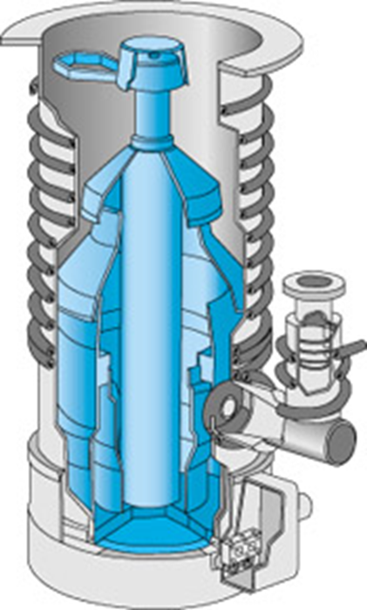
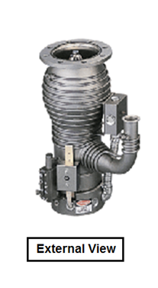
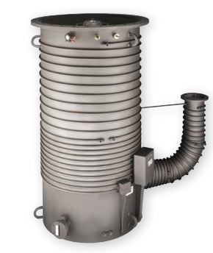
Diffusion Pumps

Slide 10
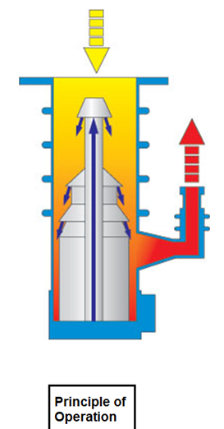
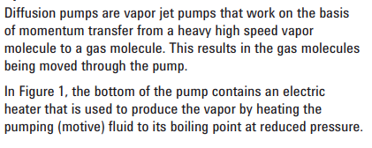
Diffusion Pumps
Rely on jets of boiling fluid (usually silicone oil) to force air particles out of the region being evacuated. Cold traps prevent back streaming.

Slide 12
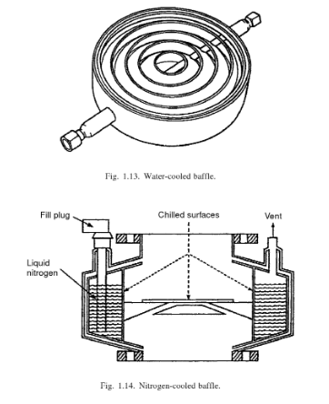

Slide 13
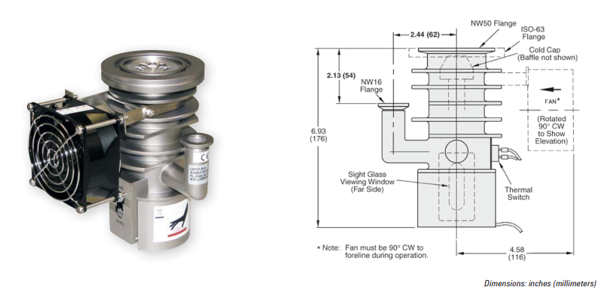

Slide 14
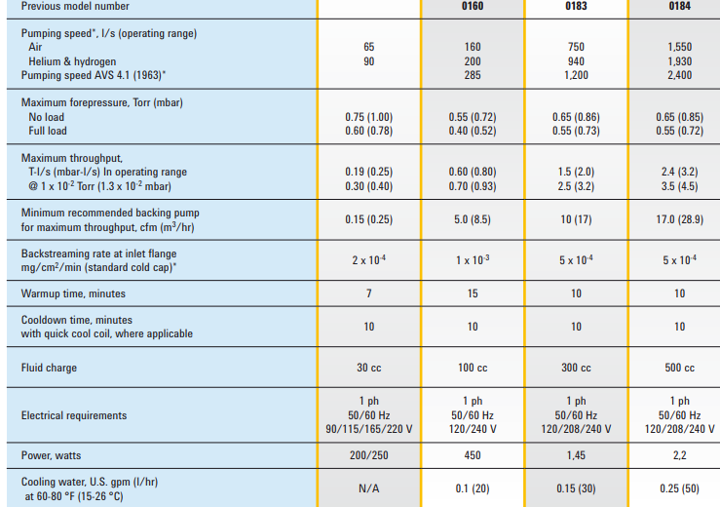
Typical Pumps Information To consider

Slide 15
نماد

Slide 16
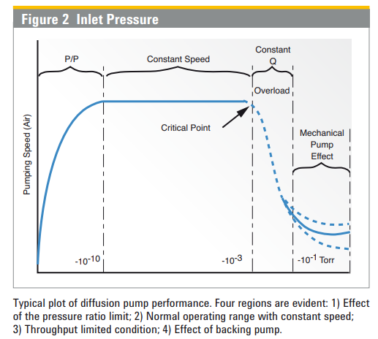

Slide 17
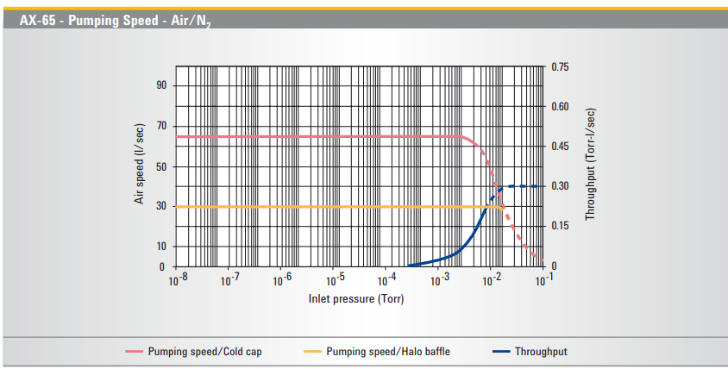

Slide 18
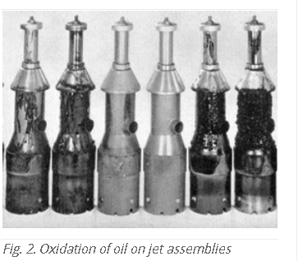
سیال روغن
1- وزن مولکولی
2- نقطه جوش
3- فشار بخار

