Slide 1
Vacuum Pumping
Gas removal
Section: Adsorption Pumps

Slide 2

How does one achieve vacuum?
Pumping – Two types
  Transfer – relies on moving molecules from low to high pressure regions
  Trapping – makes use of chemistry to trap or bury gas particles

Slide 3
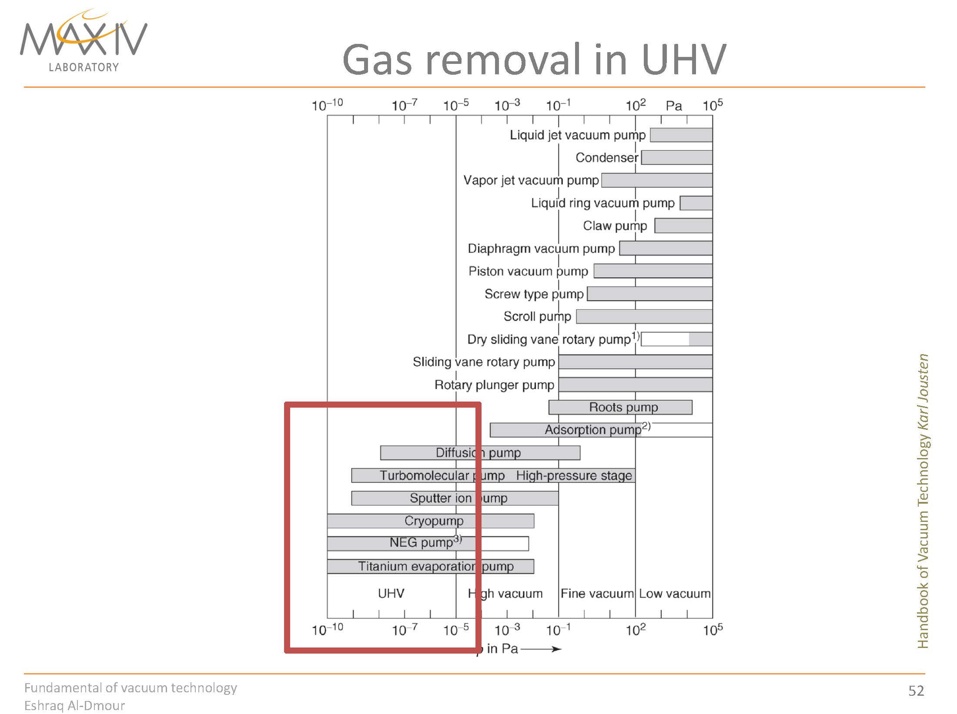

Slide 4
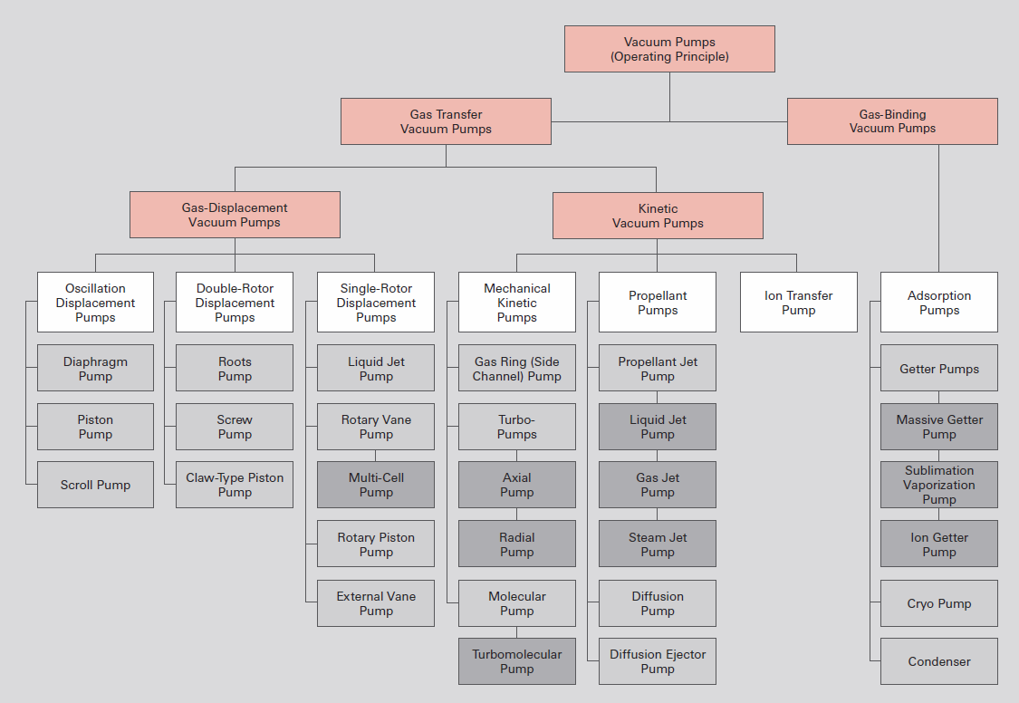
Pumping Technology
Overview of vacuum pumps

Slide 5
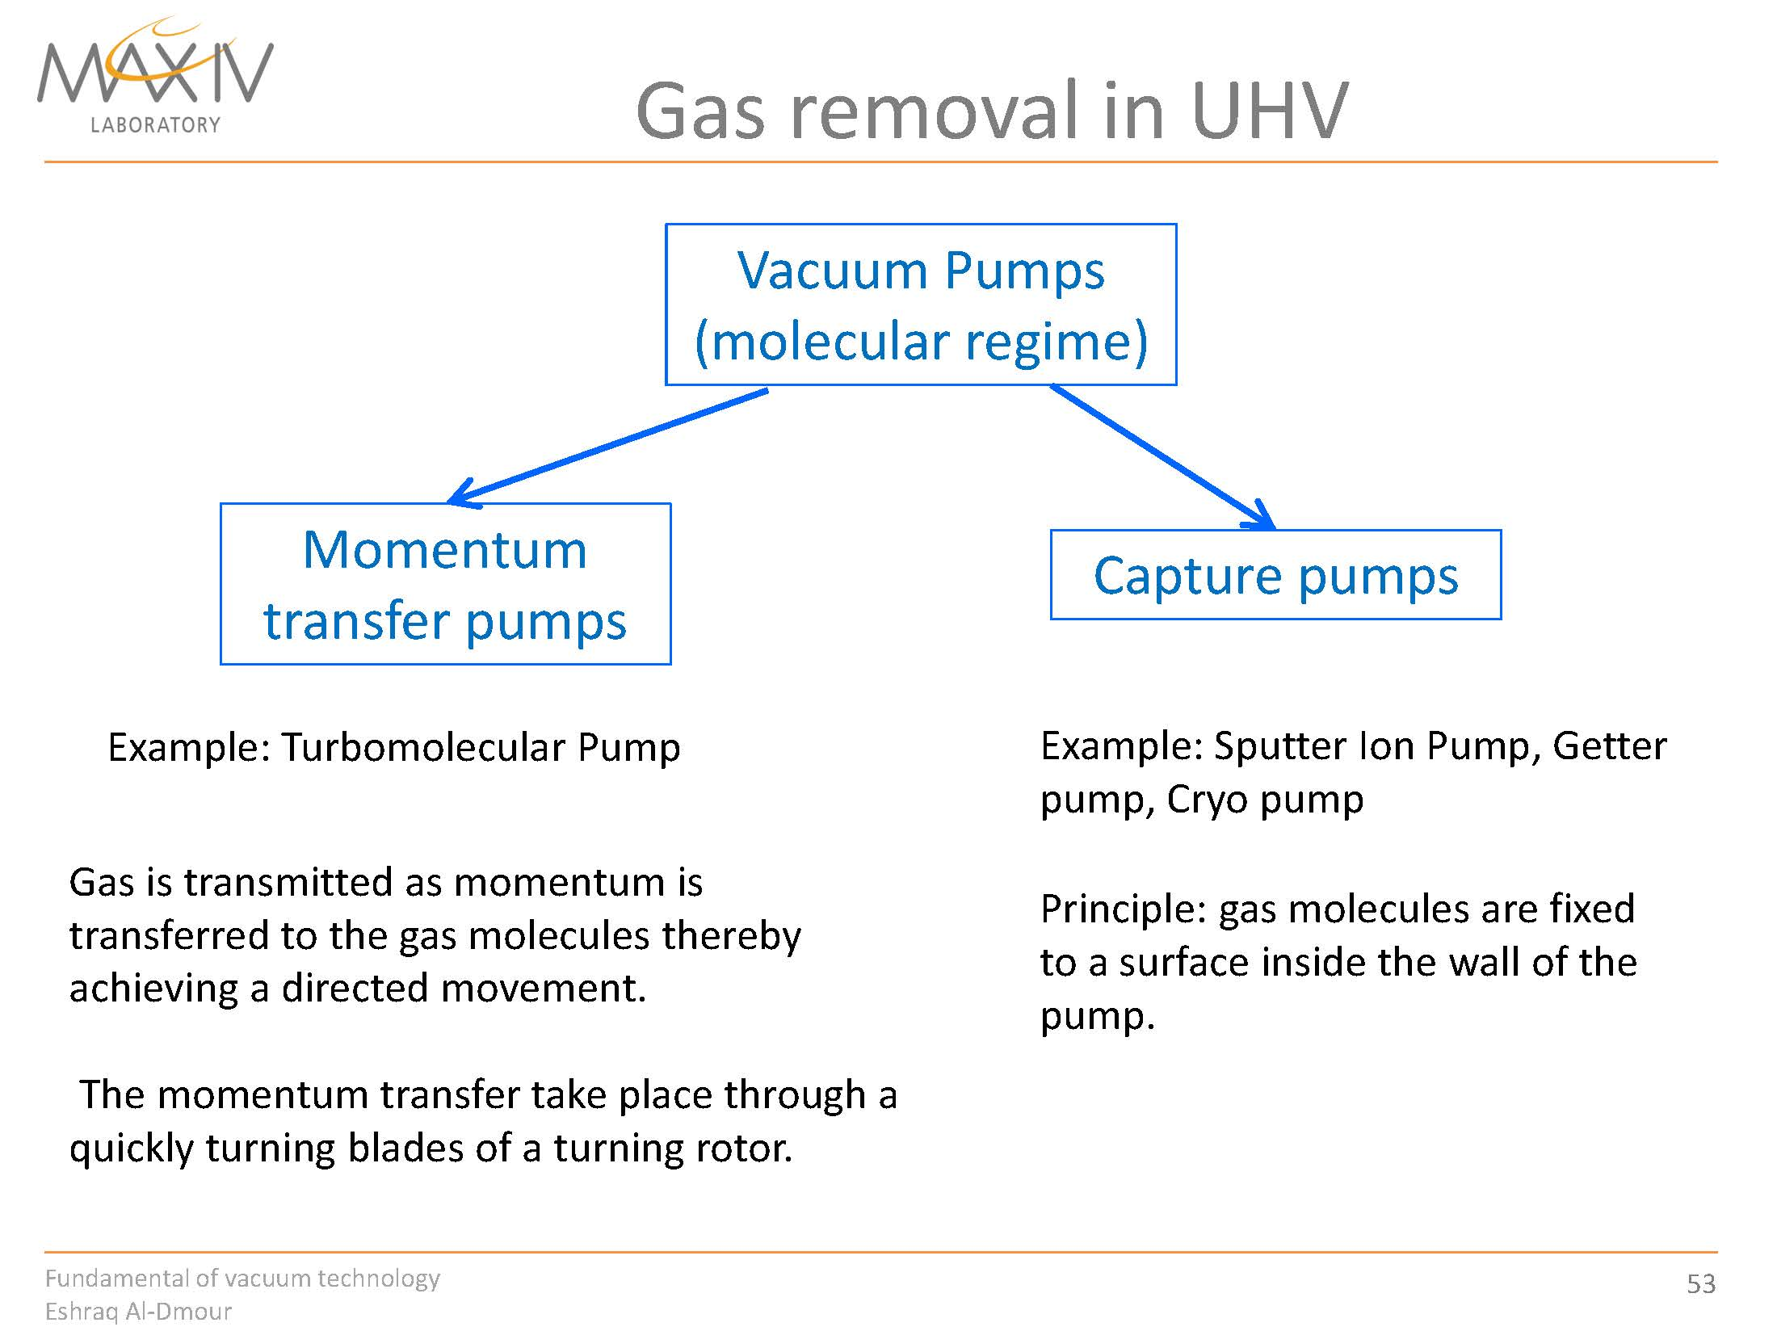

Slide 6
Cryopumps
1
2
In physics, cryogenics is the production and behaviour of materials at very low temperatures. It is not well defined at what point on the temperature scale refrigeration ends and cryogenics begins, but scientists assume a gas to be cryogenic if it can be liquefied at or below −150 °C (123 K; −238 °F).
In principle these type of pumps use a cryogenically cooled surface of activated charcoal or zeolites to condense and trap gas molecules.
By international classification, a cryopump is defined as a vacuum pump which captures the gas by surfaces cooled to temperatures below 120 K.
the development of cryopumping went in parallel with the advances made in liquefaction (liquid nitrogen, 77.3 K, Dewar, 1874; liquid hydrogen 20.4 K, Dewar, 1898; liquid helium, 4.2 K, Kammerlingh Onnes, 1908).
A cryo pump works by freezing water vapor, oil, and others gases out of the atmosphere within the users vacuum chamber or system. ... The compressed helium from the compressor flows into the piston assembly, and as the piston moves the helium gas expands and cools.

Slide 7
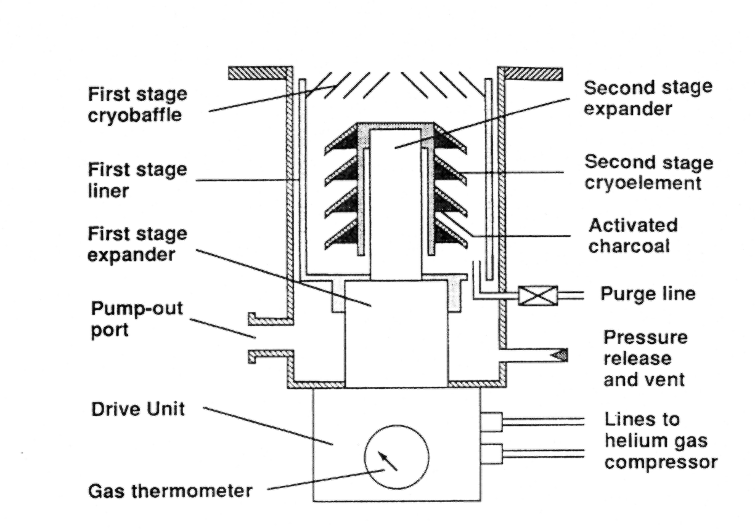
Cryogenic pump
Cryo-pumps use liquid helium and activated charcoal absorbers to pump to 10⁻¹² Torr.
The refrigerator for cryopumps normally has two-stages. While the 1st stage has a large refrigerating capacity down to below 80K, the refrigerating capacity of the 2nd stage is small but cools down to 10 to 12K. The 2nd stage of the refrigerator, and shielded from the temperature radiation by the 80K shield and 80K baffle mounted on the 1st stage.

Slide 8
ویژگی ها
Very high pumping speeds
No vibration or magnetic fields
they need periodic bake-outs into a rough pump to clean the absorbers
They are expensive to run unless used with a closed-circuit (Stirling engine) liquid He pump

Slide 9
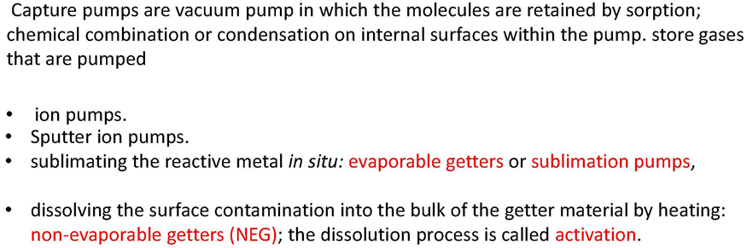

Slide 10
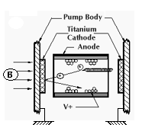
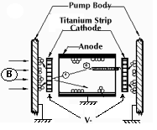
Ion pumps
1
2
An ion pump (also referred to as a sputter ion pump) is a type of vacuum pump capable of reaching pressures as low as 10⁻¹² Torr under ideal conditions. An ion pump ionizes gas within the vessel appling a strong electrical voltage, typically 3–7 kV, which allows the ions to accelerate and be captured by a solid electrode.
Main components
  Array of parallel stainless tubes
  Various charged surfaces
  Titanium or tantalum coated surfaces
Trap molecules with varying speeds via chemical reactions
Varian Scientific Instrumentation, Inc.

Slide 11
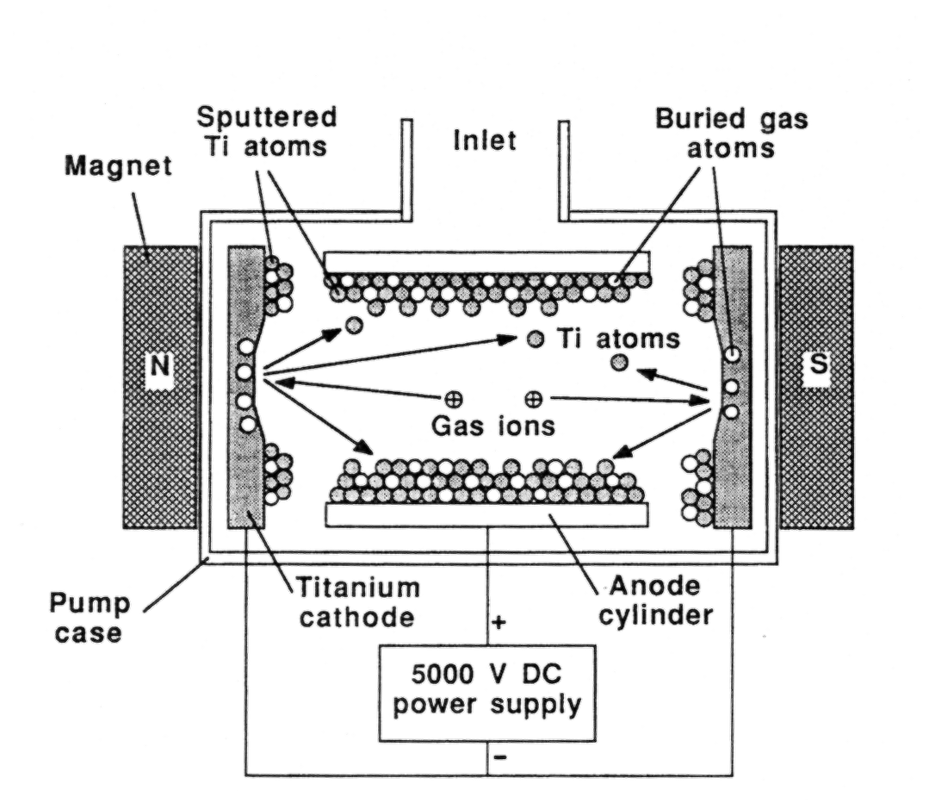
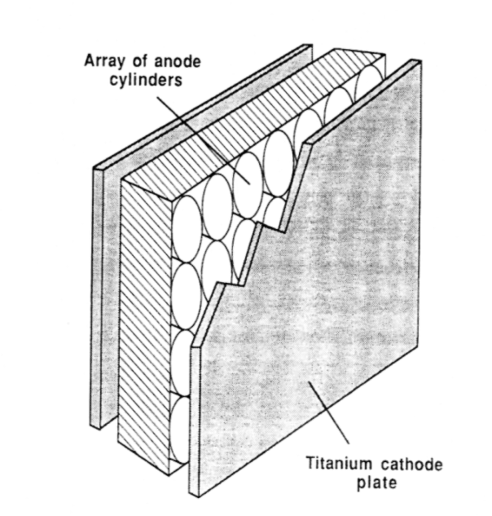
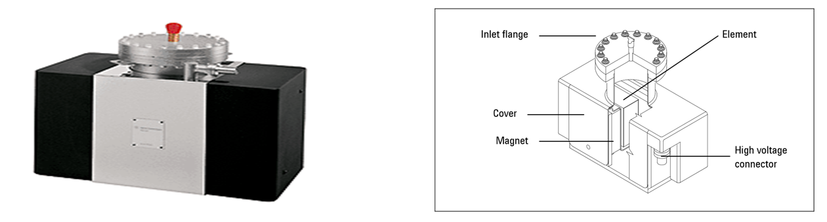
Ion Pumps
Ionized molecules spiral in magnetic field and get buried in Ti wall coating
A large number of these structures are run in parallel to improve the pumping speed
Diode pumps only handle gases that are easily ionized (no noble gases)

Slide 12
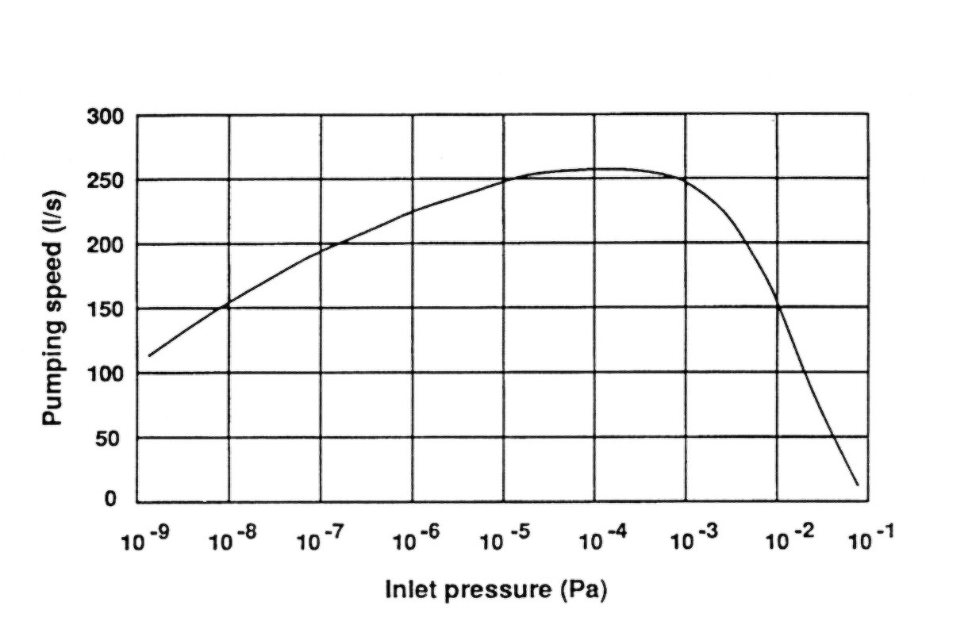
Ion pump performance
“The” UHV pump - goes to 10⁻⁹ Pa (10⁻¹¹ Torr) and below in a properly designed vacuum system
Requires no backing…more than a little misleading… in fact it works best in a sealed system. Entrainment pump!
The IP requires a periodic bake-out into rough pumped system to clean the buried gas from the pump. This is done during the gun bake procedure
Check for electrical instability by slapping the pump with an open hand. Instability indicates need for a bake
Ion Pump Performance

Slide 13
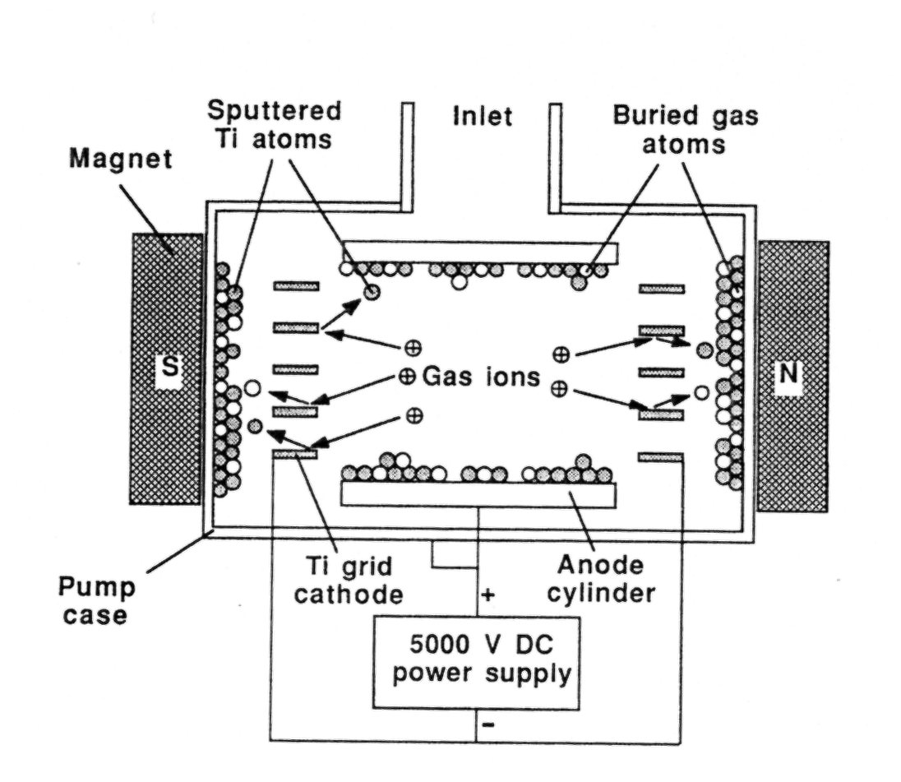
The triode pump
If noble or unusual gases are expected to be found in the SEM (nitrogen, helium, counter gases from a WDS system etc.) then a triode pump must be used.
The additional electrode then makes it possible to ionize these gases

Slide 14
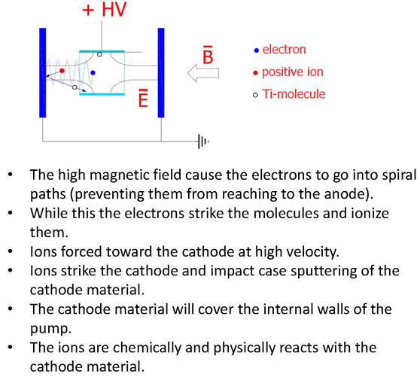

Slide 15
Getter Pumps
Getters are materials able to fix gas molecules on their surface in the form of stable chemical compounds. To do so, their surface must be clean. There are two ways of producing a clean gettering surface – by in situ deposition of a fresh getter film, – by heating an oxidized getter to a temperature high enough to diffuse oxygen from the surface into the getter bulk. In the first case we speak about evaporable getters, in the second case about non-evaporable getters (NEG) and the required heating temperature is called activation temperature.

Slide 16
Evaporable getters
The two materials most widely used as evaporable getters are barium and titanium .
Barium is usually sublimated from a BaAl4 alloy by heating at ~ 900°C. It is used for pumping vacuum sealed devices (electron tubes) and the sublimation is done in one single process before sealing. It is not used for UHV applications and will not be discussed here. For more details .
Titanium is the most widely used evaporable getter for UHV applications. It is usually sublimated from filaments made of Ti alloys (with Mo or Ta) heated up to 1500°C, temperature at which the Ti vapour pressure is about 10–3 Torr. Titanium films provide sticking probabilities of 1–5 × 10–2 for H2 and 0.4–0.6 for CO at room temperature. Cooling to liquid N2 temperature enhances these values to 0.1–0.3 for H2 and about 1 for CO .Other materials (Ta, Nb, V, Zr, Mo) have also been used, but their behaviour is not as good for various reasons

Slide 17
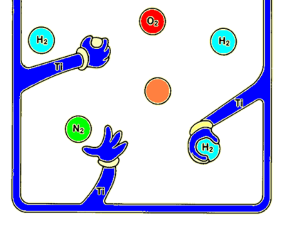
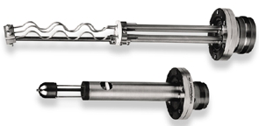
Getter Pump
Evaporable Getters
Non-Evaporable Getters - NEG
The active Ti surface is obtained under vacuum with subsequent depositions of a metal film of Ti in the system
Non evaporable getters (NEG), based on the principle of metallic surface sorption of gas molecules, are mostly porous alloys or powder mixtures of Al, Zr, Ti, V and Fe. ... The NEG acts as a getter or getter pump that is able to reduce the pressure to less than 10⁻⁷ Pa.Also in this case, a particular material alloy (NEG coating) has the property to absorb the molecules of gas. To activate the surface it is necessary to simply heat it at 250-300 C.
TSP
The titanium is heated to the sublimation temperature (about 1100 ° C).
The gas particles which collide on the layer of titanium are linked via chemi-absorption.
Main Getter Elements are:
Barium, zirconium, tantalum, molybdenum, vanadium, titanium, niobium
NEG Coating : i.e. 84% Zr; 16% Al or Zr, Fe, V
About 0,07 mm
Support: plated iron or nickel, tickeness 0,2 mm

Slide 18
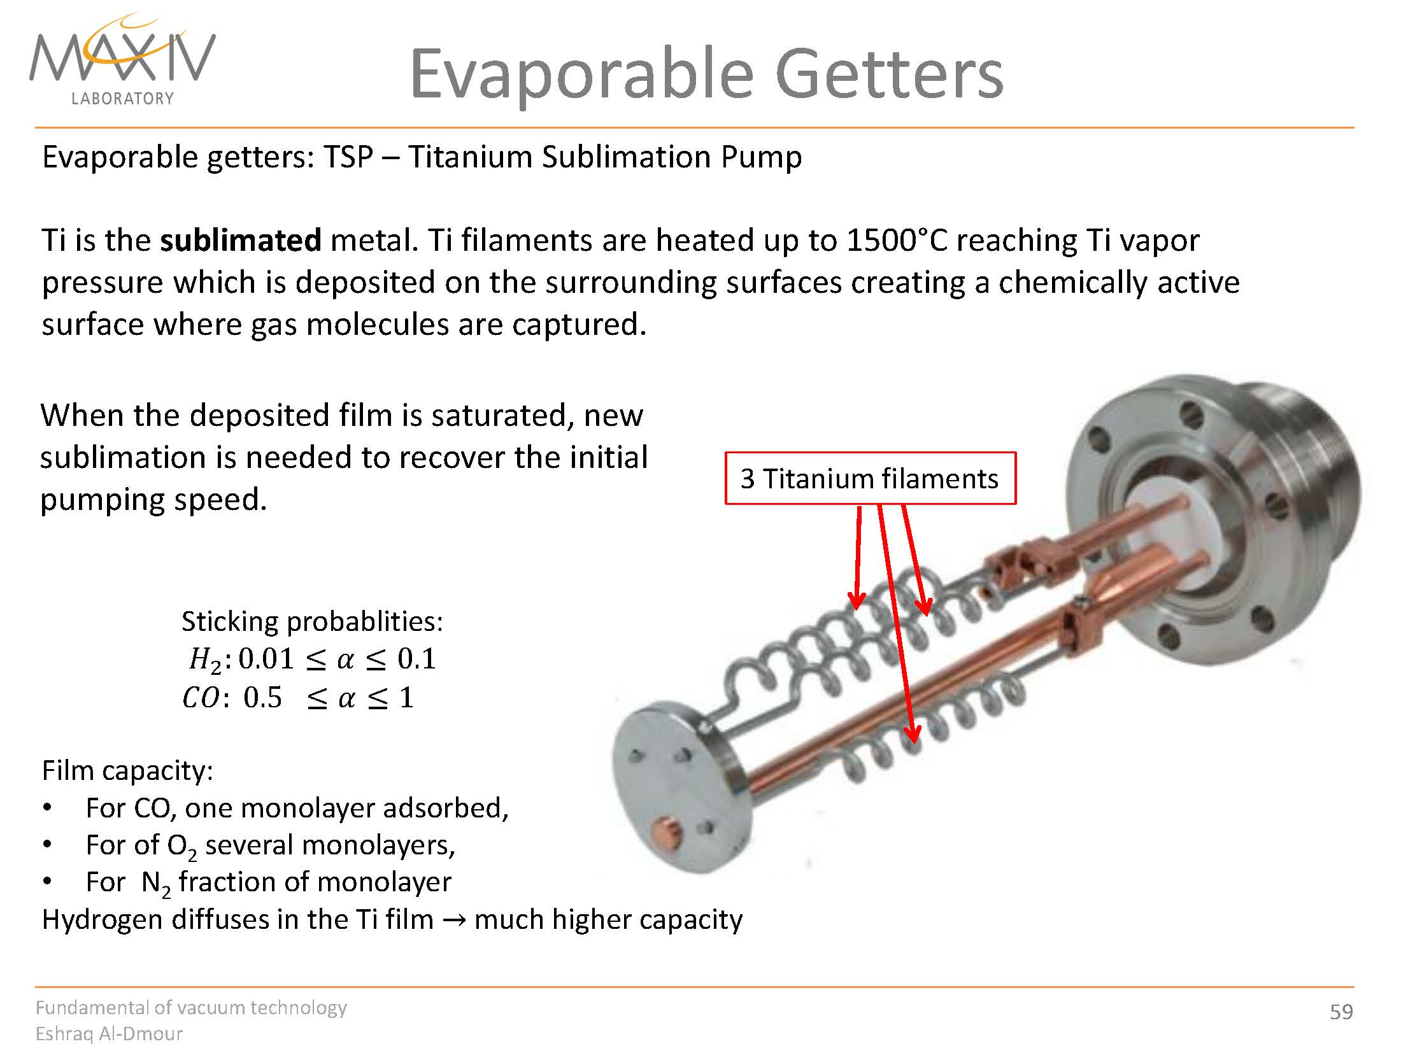

Slide 19
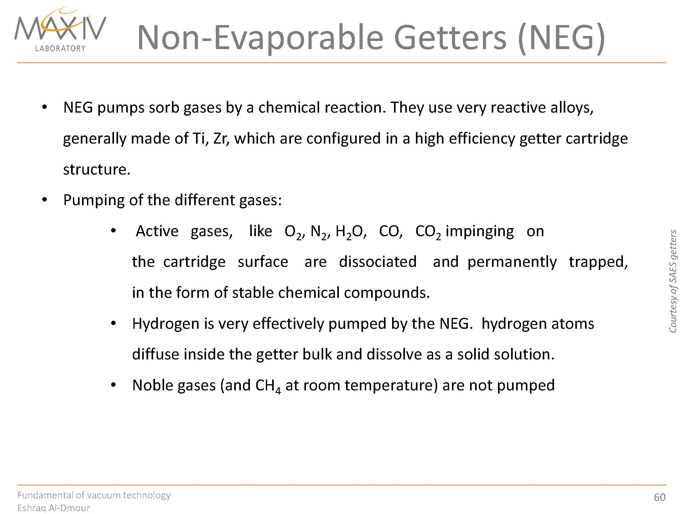

Slide 20
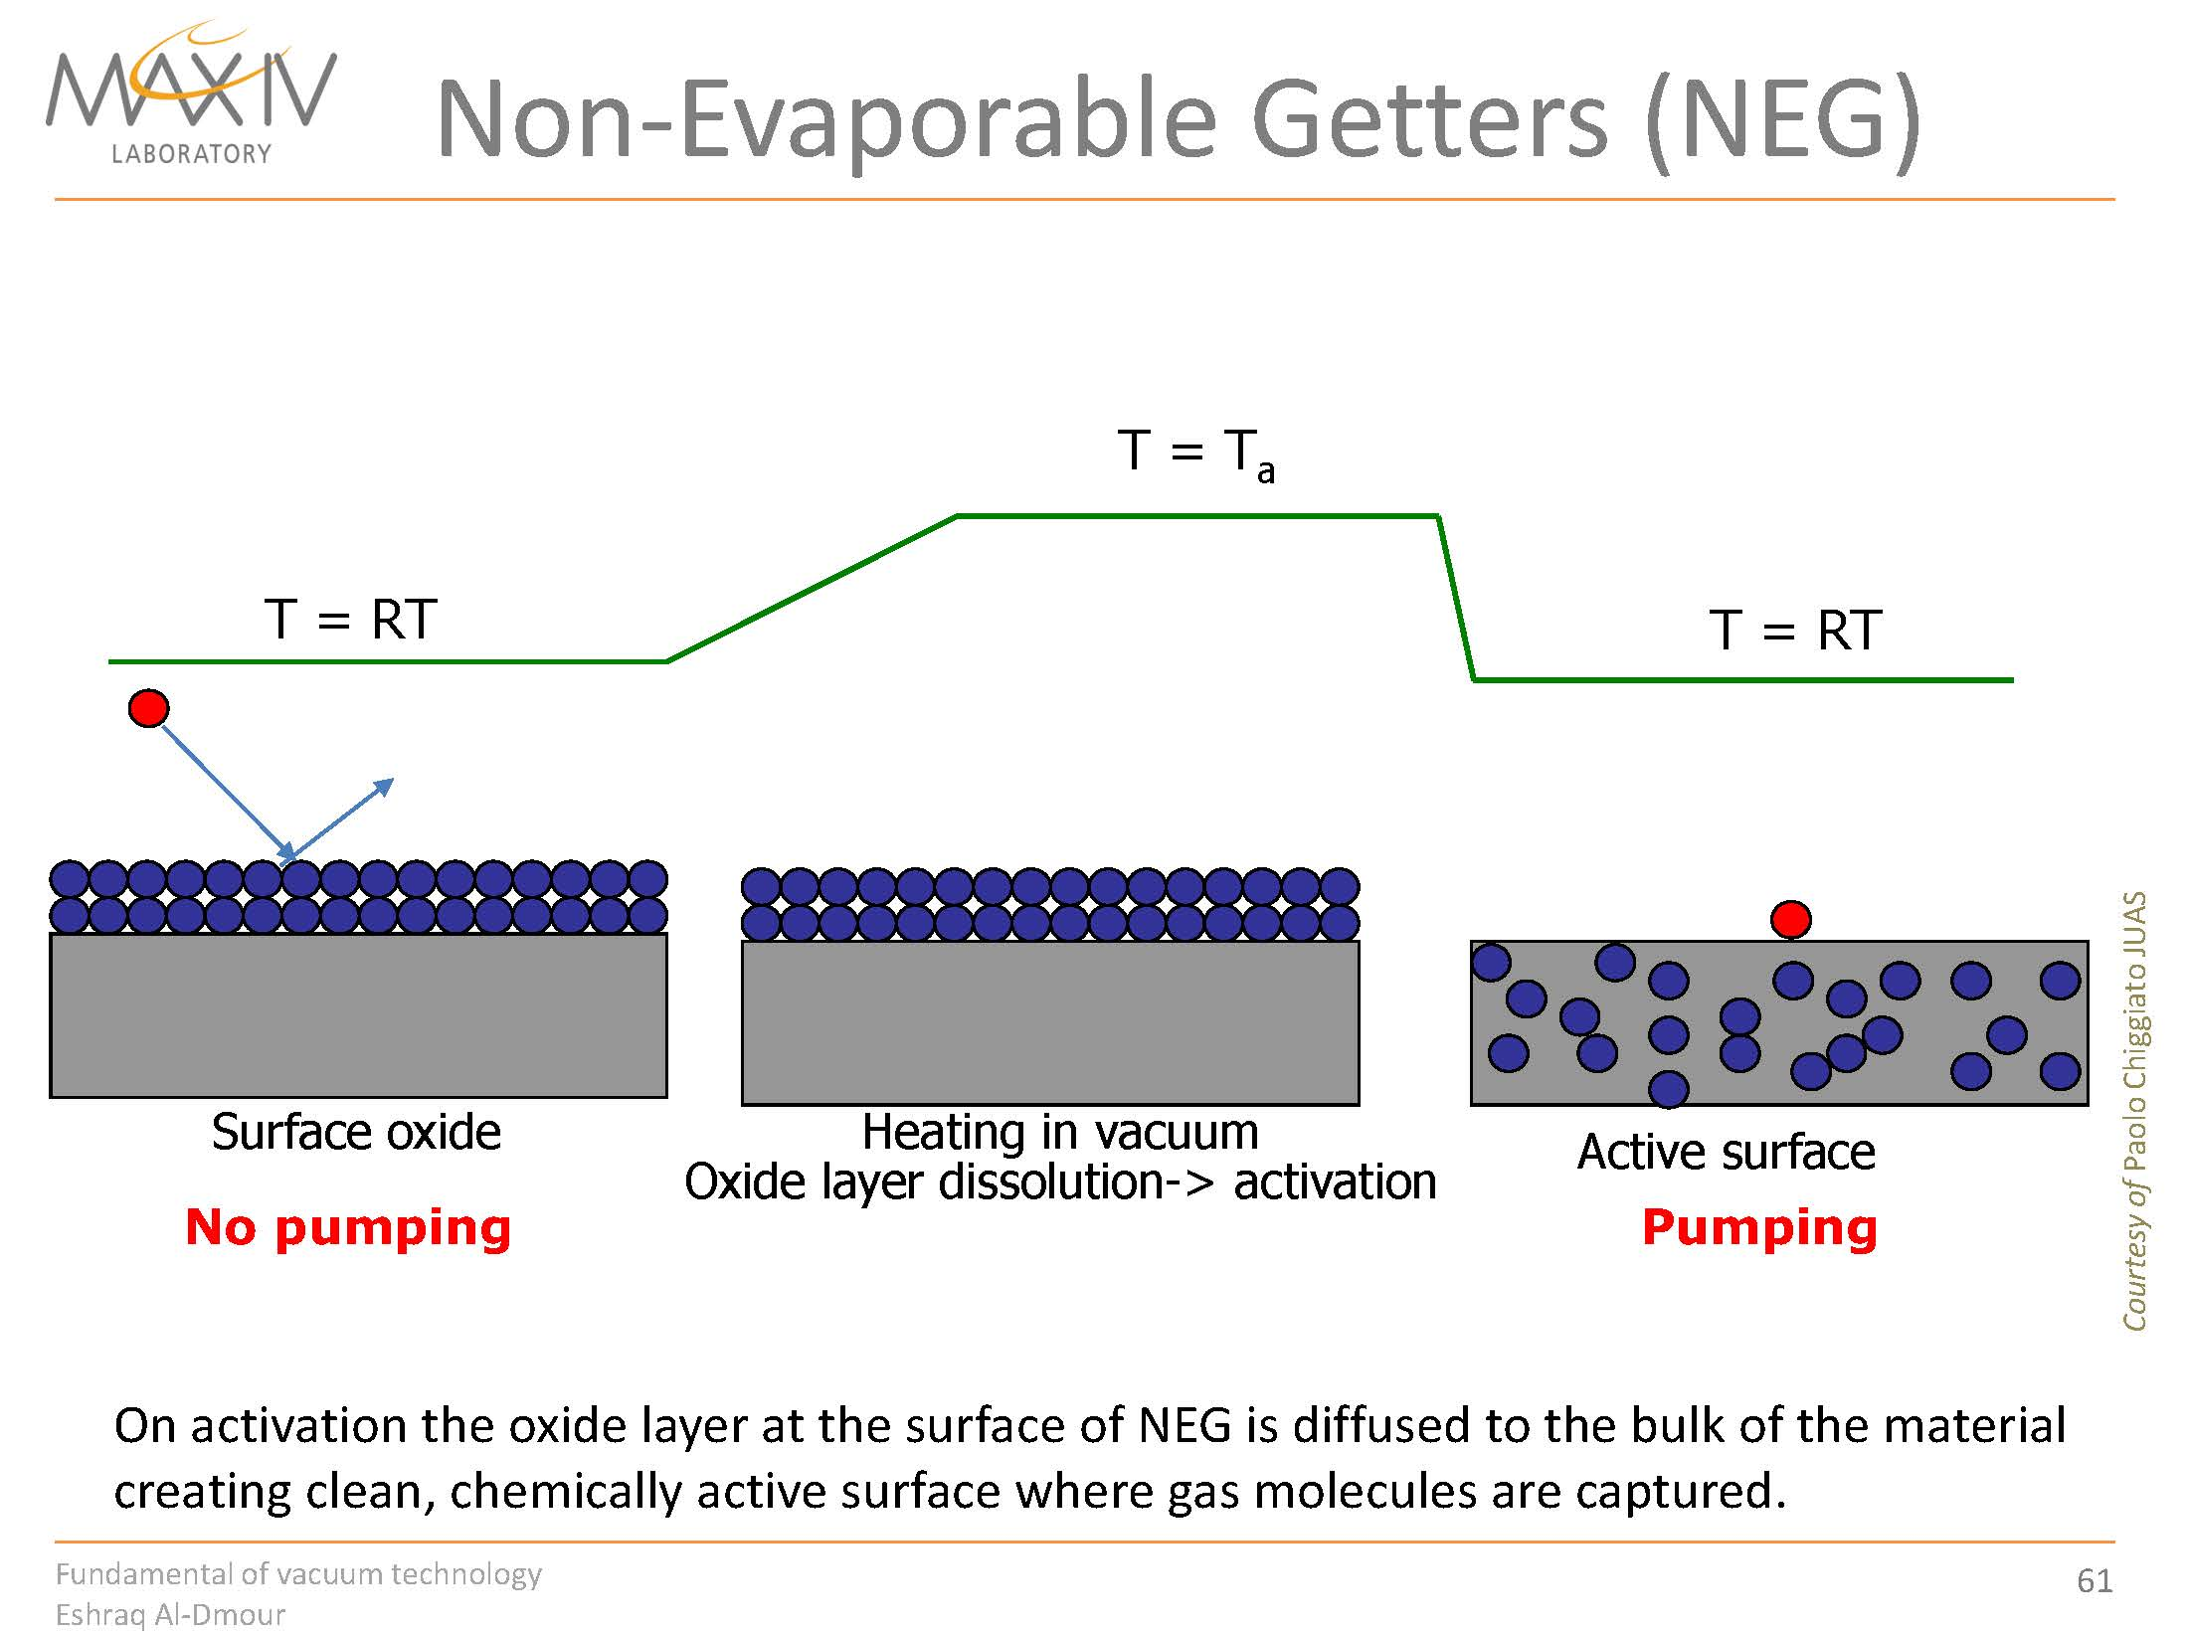

Slide 22
Finished

