Slide 1

اندازه گیری خلأ
Measuring the vacuum

Slide 2
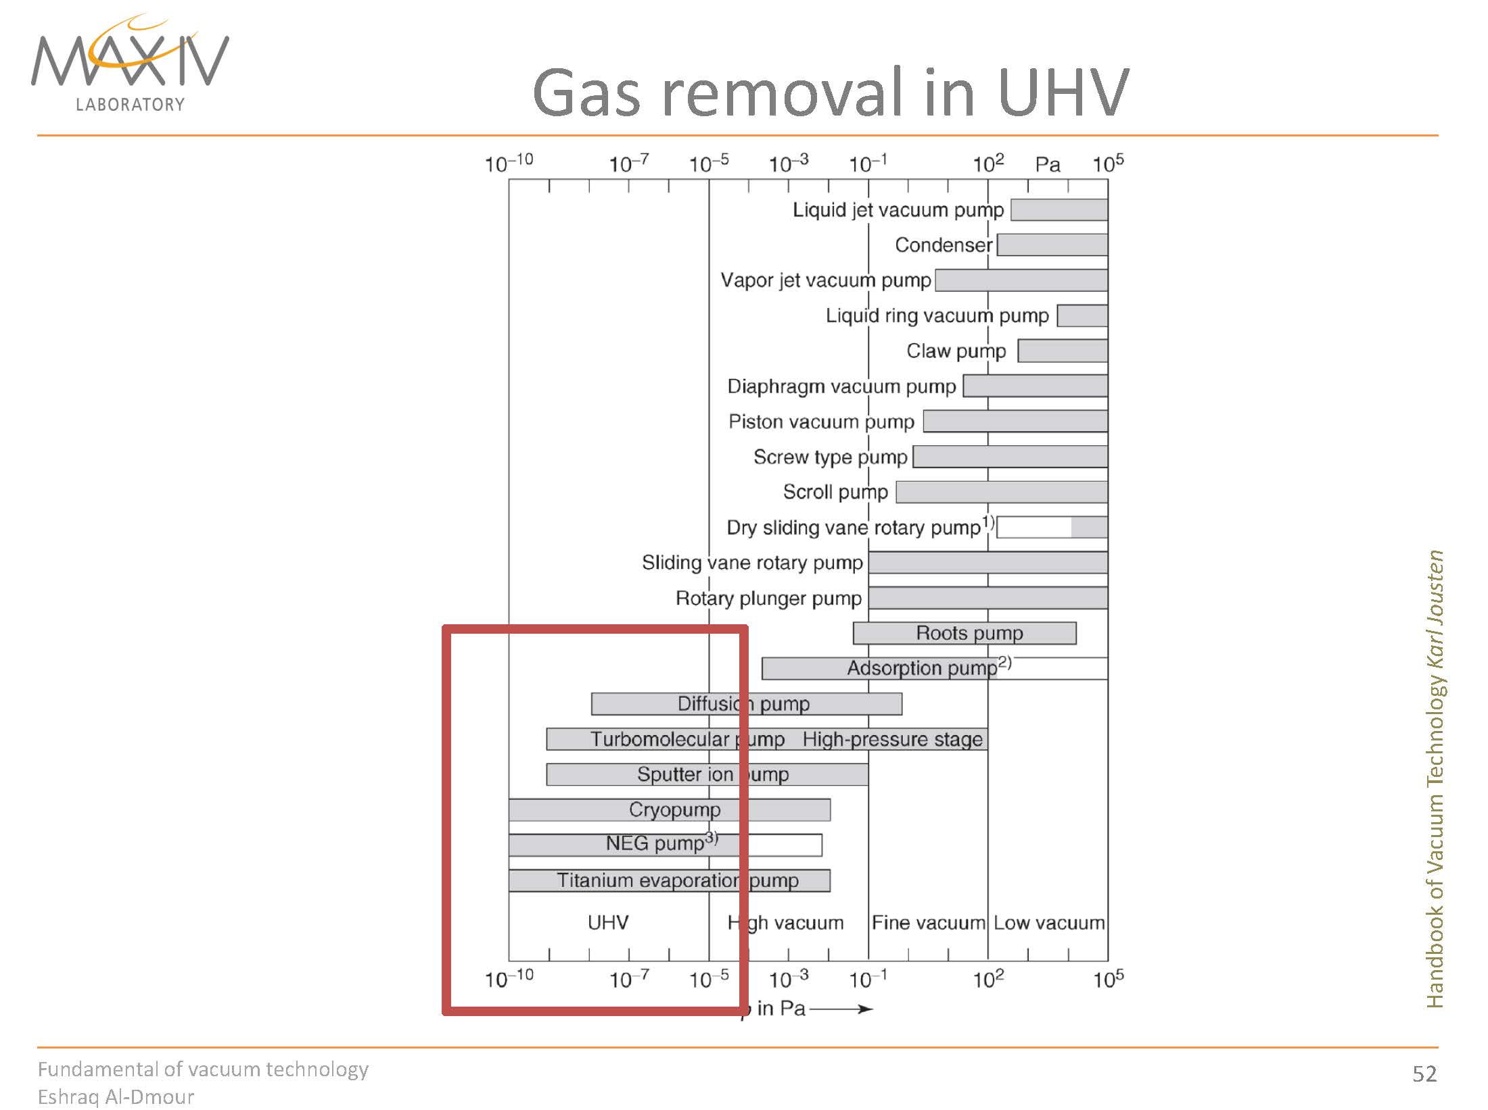

Slide 4
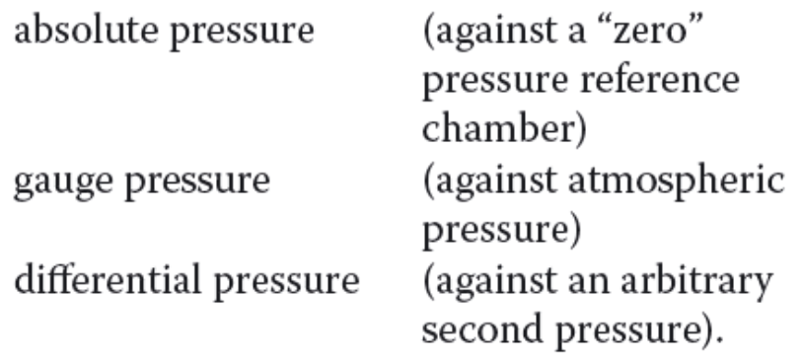
تعاریف
1
2

Slide 5
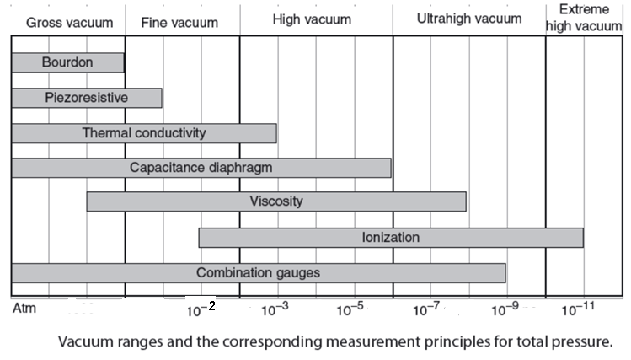
فشار سنج های خلأ
Vacuum systems must be monitored constantly to ensure satisfactory performance, but manufacturers seem to be reluctant to provide gauges which allow this to be done
Many different types of gauges are available because each only covers a limited range of pressures
Never trust a gauge unless you can check it independently
Range of gauge utility

Slide 6
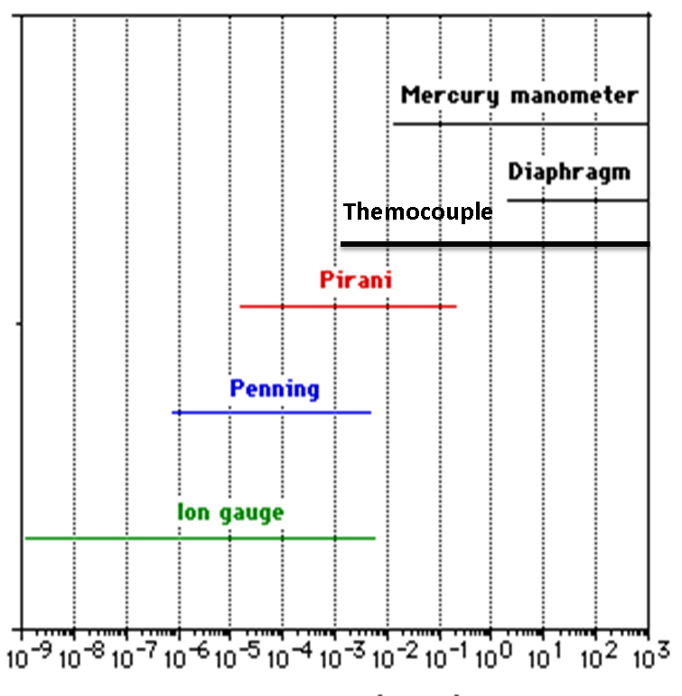

Slide 8
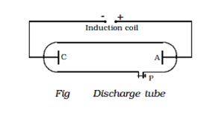
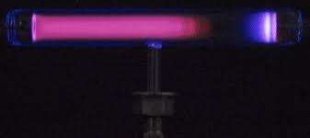
Gas Discharge

Slide 9
فشارسنج های ترموکوپل و پیرانی

Slide 10
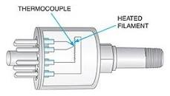
Thermocouple (or T/C) gauge ترموکوپل
The thermocouple (or T/C) gauge is one of the more common and cost effective gauges for vacuum pressure measurement in the 1 Torr to 1 milliTorr range. Like most vacuum gauges, the T/C gauge does not measure pressure directly as do, for example, manometers of the McLeod or Bourdon type. Instead, these vacuum gauges depend on changes of a physical characteristic of the residual gas within the gauge tube. In the case of the T/C gauge, and all other thermal conduction gauges, that characteristic is the thermal conductivity of the gas.
The T/C is usually found in the forelines of high vacuum systems (i.e. between the roughing and diffusion pumps) as well as in single pump systems of the sort used to evacuate sign tubes
A thermal conduction gauge may be thought of as a defective vacuum insulated thermos bottle

Slide 11
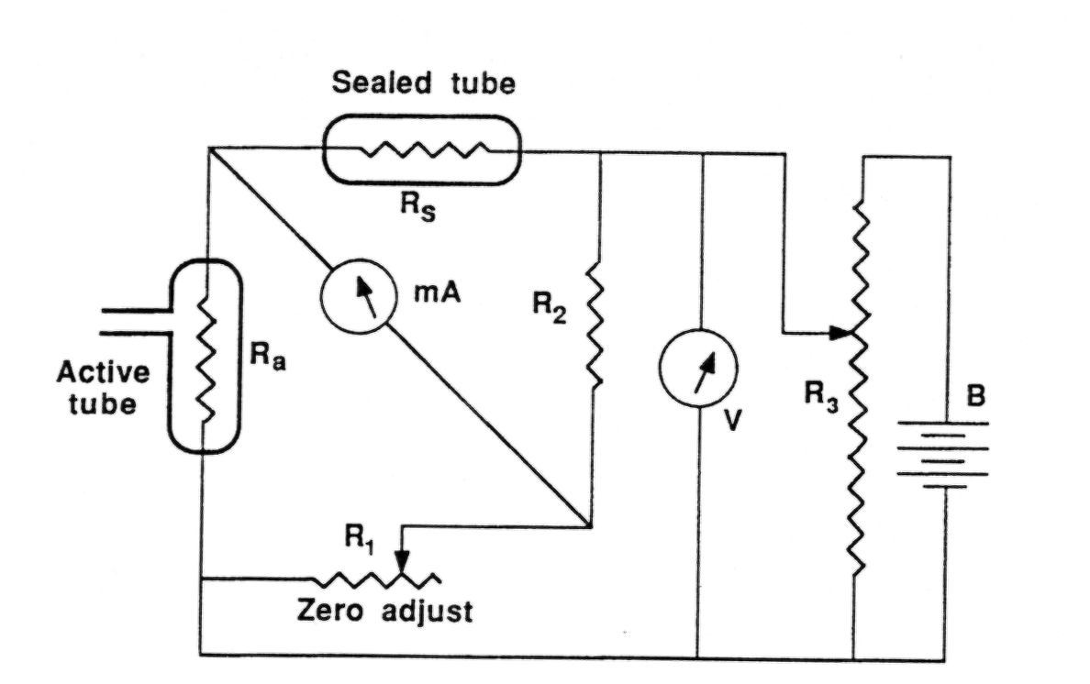
Pirani gauge
The Pirani is a dedicated low vacuum gauge device
The resistance of the hot wire changes with the rate of heat loss (conduction) to the gas
The Wheatstone bridge then measures the change in resistance of the hot wire
Pirani’s are rugged and generally reliable and rarely need attention
Schematic Circuit for a Pirani (hot wire) gauge

Slide 12
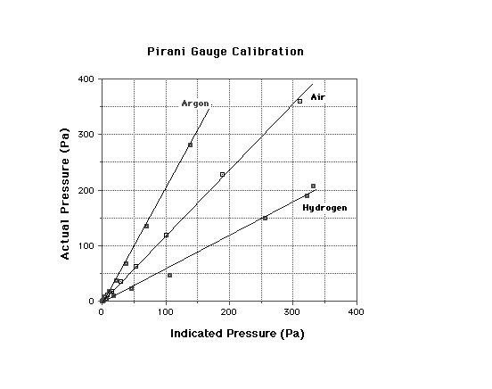
Pirani calibration
The calibration of a Pirani depends on thermal conductivity and so on the actual gas in the system
Beware when using a crystal spectrometer as gases leaking from the counter tubes will degrade the accuracy of the Pirani gauge
Correction Curve for Pirani Gauges

Slide 13
فشار سنج های مبتنی بر یونیزاسیون
1- کاتد سرد
2- کاتد گرم

Slide 14
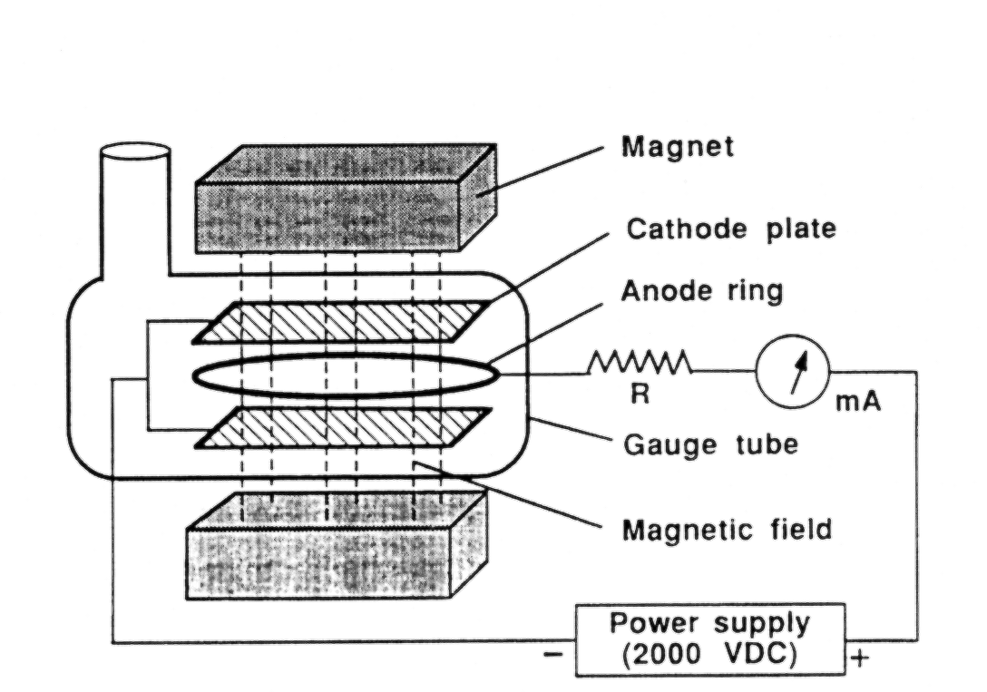
Penning (Cold cathode) Gauge
A Penning gauge measures the ion current flowing from the cathode to the anode
The magnetic field increases sensitivity by making the ions spiral as they travel to cause secondary ionization
Beware - a Penning gauge reads zero current when the pressure is both very low and very high. The gauge must ‘strike’ to be operational
Check with a Pirani gauge if in doubt
Penning gauges require routine cleaning and testing

Slide 15
Ion Gauge فشار سنج یونی
  Filament emits electrons which circle the grid, bombard with gas molecules to create ions, which are subsequently accelerated toward the collector.
MDC Vacuum, Inc.

Slide 16
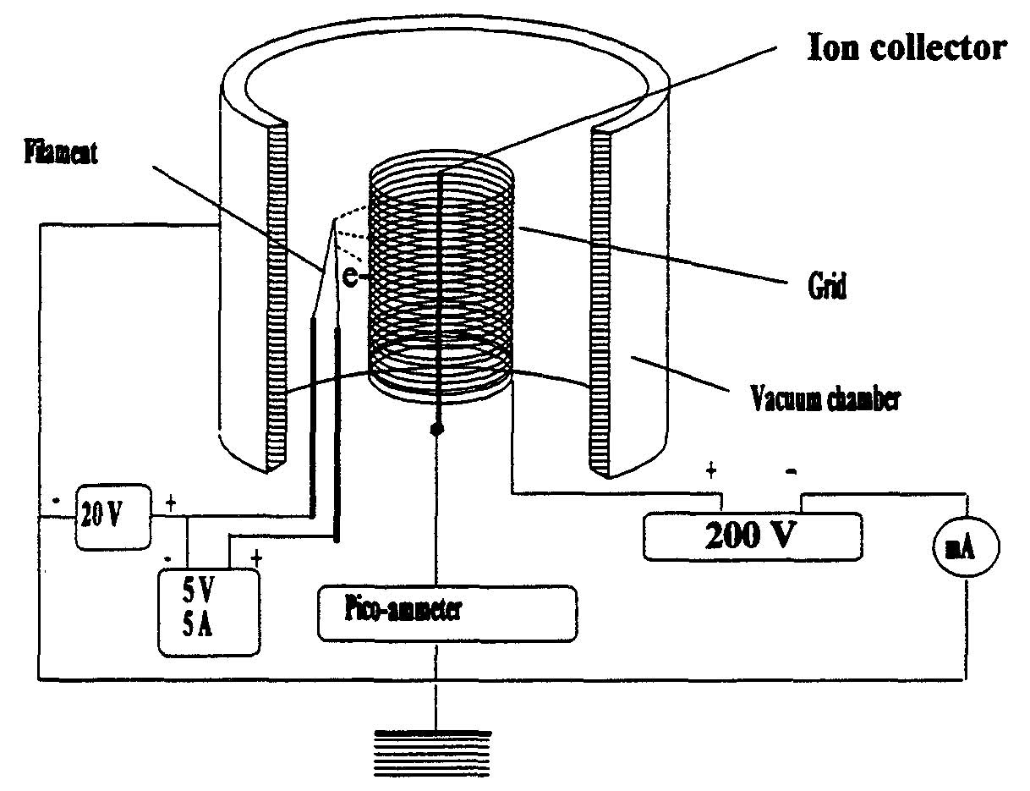
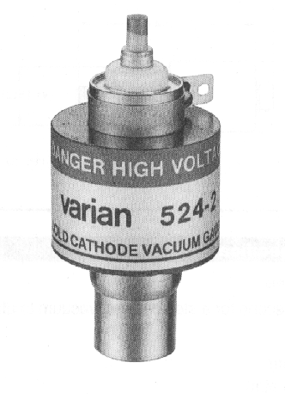
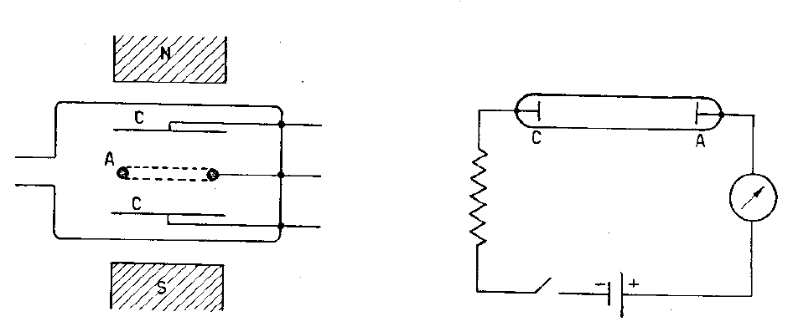
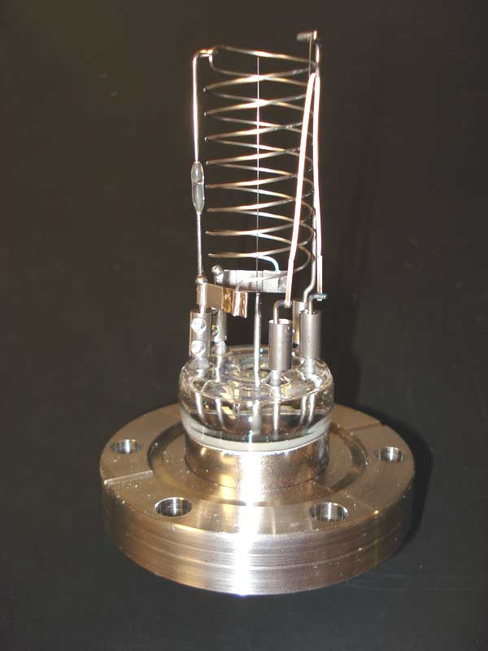
Vacuum Gauge based on Ionization Probability
Penning gauge: more stable, less precise
cold-cathode gauge
2 electrodes: anode, cathode+ permanent magnetic field
invented 1937 by Penning
precursor of sputter-ion pump
nonlinear dependence
Bayard-Alpert gauge: less stable, more precise
hot-cathode gauge,
3 electrodes: filament, collector, grid
invented 1950, revolution in vacuum technology linear dependence
Here the pressure is measured through a gas discharge in the gauge head where the gas discharge is obtained by applying a high voltage.
The pressure range from 10⁻⁴ to 1 x 10⁻⁹ mbar.
Molecules are ionized and collected.
Pressure reading is determined by the electronics from the collector current.
Advantages:
The sensitivity of the device is more different for each gas;
is necessary to degas the head of measure to avoid outgassing
Advantages:
is rugged enough
is resistant to sudden variations of pressure.
Low tendency for contamination (also during argon operation) due to high voltage reduction after ignition of the plasma and due to the titanium cathodes

Slide 17
پایان

