Slide 1
Materials In Vacuum Technology
مواد در فناوری خلأ

Slide 3
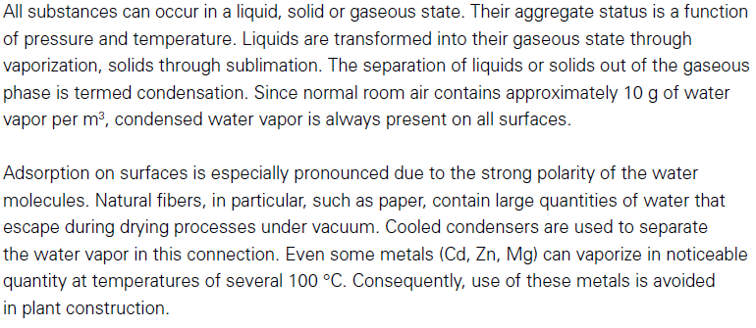
Vapor Pressure (Vaporization and Condensation)

Slide 4
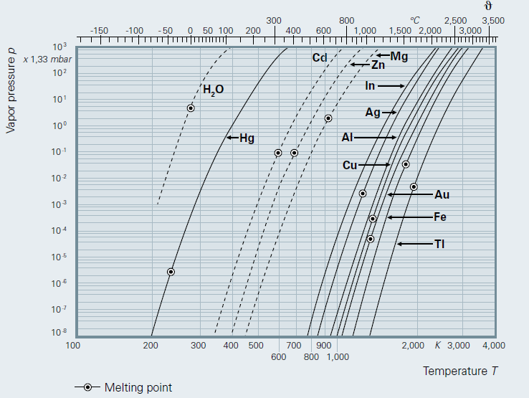

Slide 5
Outgassing in Vacuum

Slide 6
Outgassing
خروج گازهای جذب شده در جداره های داخلی سیستم به داخل سیستم خلأ، که به صورت آرام صورت می گیرد اصطلاحا آوتگسینگ گفته می شود و با افزایش دما افزایش مییابد .
نمایش داده میشود و واحد آن فشار-حجم بر زمان است.K و با
مهمترین گازی که در ابتدا دفع میشود بخار آب است که عمدتا از راه هوا جذب سطوح داخلی میشود.سایر گازها به مقادیر کمتر نظیر هیدروژن، مونو و دی اکسید کربن و.....عمدتا در زمان فرایند های آماده سازی سطوح اتفاق می افتد.
6

Slide 7
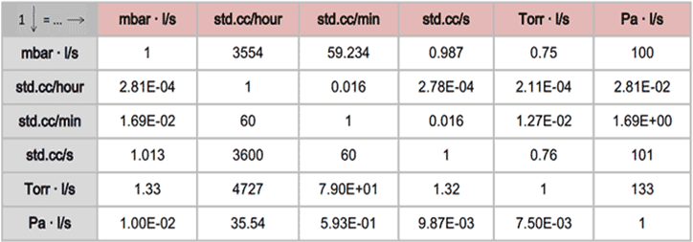
تبدیلات (PV )

Slide 8
Materials Outgassing
ماده | $K_{1}$x${10}^{−7}$(Torr-lit)/(sec-${cm}^{2})$ پس از 1 ساعت | $K_{4}$x${10}^{−7}$(Torr-lit)/(sec-${cm}^{2})$ پس از 4 ساعت
فولاد زنگ زده | 44 | 5.5
فولاد زنگ نزن | 1.75 | 0.4
فولاد زنگ نزن براق و چربی زدایی شده | 1 | 0.05
آلومینیم شسته شده | 1
مس | 23
برنج | 10 | 2.5
نایلون | 120 | 60
لاستیک سیلیکون گاززدایی شده با نیتروژن | 13
اورینگ نیتریل | 10 | 6
اورینگ نیتریل پخته شده در 100 درجه 4 ساعت | 10 | 0.7
اورینگ وایتون | 10 | 3
اورینگ نیتریل پخته شده در 150درجه 4 ساعت | 0.1 | 0.003

Slide 10
Materials in Vacuum
Outgassing of materials can be the limiting factor in achieving good vacuum.
It is usually best to use all stainless steel, aluminum, glass and copper.
Elastomer gaskets and o-rings should be specifically manufactured for vacuum applications.
NEVER USE:
Brass, zinc, or other alloys without first looking up the outgassing rate (should be less than 10⁻⁴ W/m²).
*O’Hanlon, Users Guide to Vacuum Technology, Wiley (1980).

Slide 11
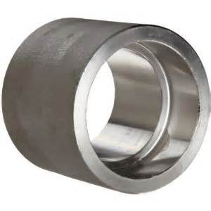
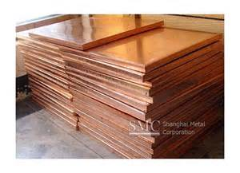
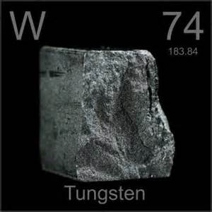
Materials to use: Metals
STAINLESS STEEL
Most common choice in HV and UHV systems
304 – common,
304L – Low carbon variant of 304 especially in UHV systems
321 – for when low magnetic permeability is required
BUT…. Avoid 303 grade – contains sulphur and tends to outgas
COPPER (Oxygen-free) C10100 & C10200
‘Oxygen-free’ type is widely used
Easy to machine
Impermeable to hydrogen and helium
Low sensitivity to water vapour
TUNGSTEN
Can be used at high temperatures
Can be used for filaments
BUT…Becomes brittle when work-hardened
ALUMINIUM & AL ALLOYS
Low outgassing
Easy to machine
Low weight and lower cost
BUT…Some alloys contain a high proportion of Zinc ; Must NOT be anodised; Poor strength at high temperatures ;
Not easy to weld

Slide 12
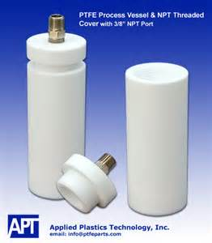
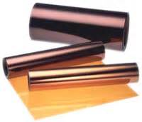
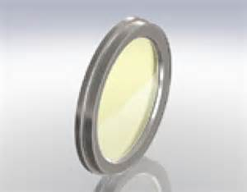
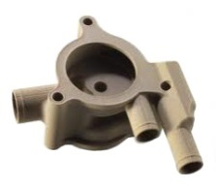
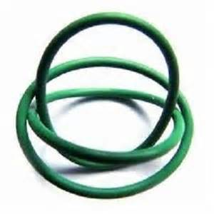
Materials to use: Ceramics
Materials to use: Polymers
PORCELAIN AND ALUMINA
Excellent electrical insulation
Non-porous if fully vitrified
Low coefficient of thermal expansion – usable to 1500ºC
BOROSILICATE GLASS
Used for viewports
Can be machined and joined with metals
Low coefficient of thermal expansion – resistant to thermal shock
PTFE-TEFLON
Good electrical insulator
Tolerant to high temperatures
Low outgassing
BUT…Cannot be used as a barrier between vacuum and atmosphere as it is permeable to gases
KAPTON
Good electrical insulator
Tolerant to high temperatures
Very low outgassing
Available in tape and film form
PEEK – Polyether ether ketone
Excellent mechanical & chemical resistance
Suitable for UHV applications
Very low outgassing
BUT…Has a melting point of 343ºC
VITON
Used for demountable seals (‘O’ rings etc.)
Can also be used as a seating face in valves
Good electrical insulator
Good chemical resistance
Bakeable to 200ºC

Slide 13
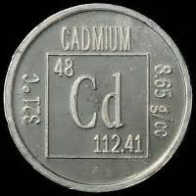
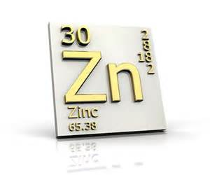
Materials To Avoid
because of the high vapor pressure
CADMIUM
Often present in the form of plating (fasteners etc.) or in some brazing alloys
ZINC
Is a problem in high vacuum and high temperatures. Present in some alloys like brass (some electrical fittings)
MAGNESIUM
Low melting point (650ºC at atmosphere). Contains free hydrogen gas
PVC
Often found in wire insulation, dust caps etc.
POLYMERS
Many have an affinity to water
Especially plastic tapes. Mould release residue can be an issue too. Polymers may generate a static charge attracting dust
Nylon has a high outgassing rate

Slide 14
Permeability and Other Gas Sources
A single viton seal on a flange, gate valve bonnet or pump inlet will limit the ultimate pressure to >10⁻⁹ mbar.
Unbaked systems will rarely reach better than 10⁻⁸ mbar.
Trapped volumes or virtual leaks will increase pump down time.
Microscopic air leaks can limit the ultimate pressure.
The use of a mass spectrometer on a regular basis will help to identify the nature of the gas source.

