Slide 1

علوم و فناوری خلأ
Vacuum Science and Technology

Slide 2
منابع پیشنهادی جهت مطالعه بیشتر
Foundations of Vacuum Science and Technology; J. M. Lafferty, wiley
Fundamentals of vacuum Techniques; A. Pipko, V. Pliskovsky, B. Korolev, V. Kuznetsov; English translated by Boris Kuznetsov, Mir publisherss
Basic Vacuum technique, A. chambers, AIP pulishing
IAEA, Training guidelines in non-destructive Testing Techniques: Leak Testing at Level 2.
LEAK DETECTION, N. Hilleret, CERN, Geneva, Switzerland.
Fundamentals of Vacuum Technology, Leybold Vacuum.
LINEAR QUADRUPOLES IN MASS SPECTROMETRY, D.J. Douglas
تکنولوژی خلأ مهندس تیمور رفیعی زاده
مهندسی خلأ، مهندس تیمور رفیعی زاده، داوود محبوبی
خلأ سازی و خلأ سنجی، کاربردهای علمی و صنعتی آن، دکتر صمد فرخی
مقدمه ای بر فیزیک و تکنولوژی خلأ، دکتر علی معتمد
فن آوری خلأ، دکتر مهدی خراسانی
تکنیک خلأ دکتر مهدی حاج ولینی

Slide 3
A Vacuum System

Slide 4
1. Vacuum physics Quantities, their symbols, units of measure and definitions
2- Vacuum Generation
3. Vacuum measurement, monitoring, control and regulation
4- Leaks and their detection
5- Application of vacuum technology
6- Instructions for vacuum equipment operation
7- Tables, formulas, nomograms, diagrams and symbols
8- National and international standards and recommendations particularly relevant to vacuum technology

Slide 5
Vacuum
A perfect vacuum is a region of space which is free of all matter. How perfect a real vacuum is can be quantified in terms of the absolute pressure inside a chamber. The lower the pressure, the "better" or "higher" the vacuum.

Slide 6
Monolayer Time
We define the monolayer time as the time for one atomic layer of gas to adsorb on the surface: τ = 1 / (SZA).
At 3 x 10⁻⁵ Torr, it takes about one second for a monolayer of gas to adsorb on a surface assuming a sticking coefficient, S = 1.
At 10⁻⁹ Torr, it takes 1 hour to form a monolayer for S = 1.
For most gases at room temperature S<<1, so the monolayer time is much longer.
Sticking Coefficient
S = # adsorbed / # incident
Impingement rate for air:
Z = 3 x 10²⁰ P(Torr) cm⁻² s⁻¹
Area of an adsorption site:
A ≈ 1 Å² = 10⁻¹⁶ cm²

Slide 7
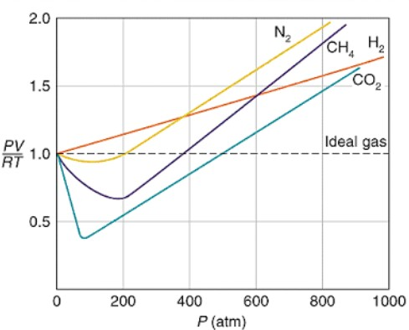


Slide 8
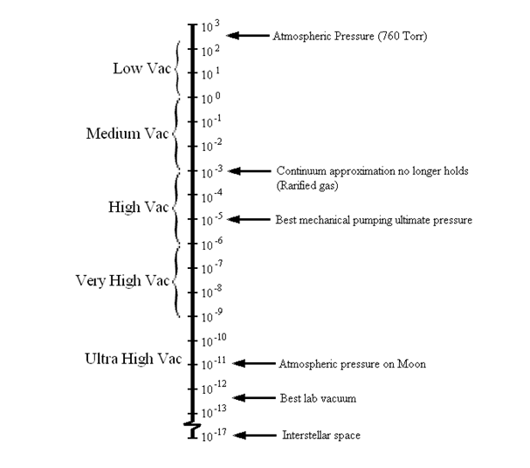
تقسیم بندی خلأ
Low or rough vacuum 760 to 1 Torr
Medium vacuum 1 to 10⁻³ Torr
High vacuum 10⁻³ to 10⁻⁶ Torr
Very high vacuum 10⁻⁶ to 10⁻⁹ Torr
Ultra-high vacuum 10⁻⁹ and lower
Laminar Viscos
Transitional
molecular

Slide 9
Pressure Ranges
Rough vacuum >1 mTorr
  Rotary vane pump
  Thermocouple, Pirani or Capacitance Manometer
Medium Vacuum 10⁻⁸ Torr < P < 1 mTorr
  Cryo pump, Diffusion Pump, Turbo Pump, Ion pump
  BA Ion gauge, mass spectrometer
  Viton seals
High to Ultra High Vacuum 10⁻¹⁰ Torr < P < 10⁻⁸ Torr
  All Metal Seals
  Baked system
  BA Ion Gauge, mass spectrometer
  Turbo, Ion, Titanium Sublimation Pump,Cryo pump.
*O’Hanlon, Users Guide to Vacuum Technology, Wiley (1980).

Slide 10
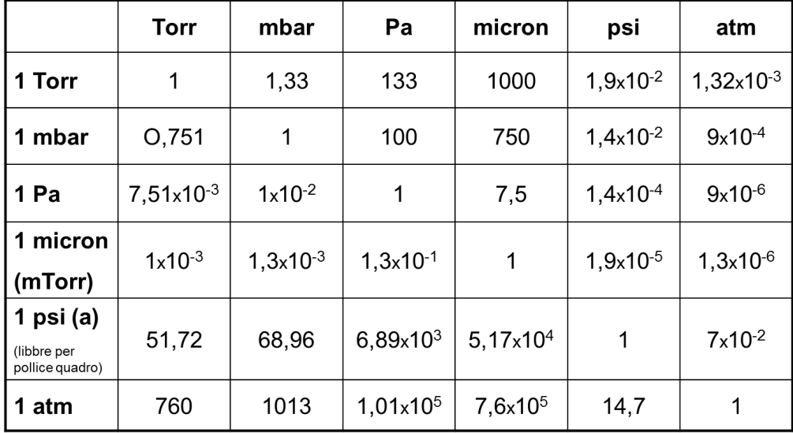
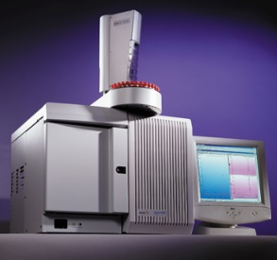
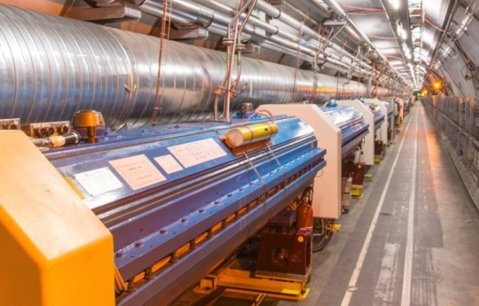
Pressure measurements and Vacuum Classification
Extreme UltraHigh Vacuum (XHV)
~10⁻¹² mbar
Low Vacuum
(LV)
30 to 10³ mbar
Medium Vacuum (MV)
10⁻³ to 30 mbar
Very High Vacuum (VHV)
10⁻⁶ to 10⁻⁹ mbar
Ultra High Vacuum (UHV)
10⁻⁹ to 10⁻¹² mbar
Industrials Scope
High Vacuum (HV)
10⁻³ to 10⁻⁶ mbar
Particles Accelerator -P~10⁻⁸-10⁻¹⁰ mbar
NB: P=10⁻¹⁰ mbar
∼ 10⁶ molecules/cm³ !!!

Slide 11
Vacuum Systems
A vacuum system consists of chamber, pumps and gauges.
Chambers are typically made of glass or stainless steel and sealed with elastomer or metal gaskets.
Pumps include mechanical, turbomolecular, diffusion, ion, sublimation and cryogenic.
Gauges include thermocouple for 1 to 10⁻³ mbar and Bayard-Alpert for 10⁻³ to 10⁻¹¹ mbar.

Slide 12
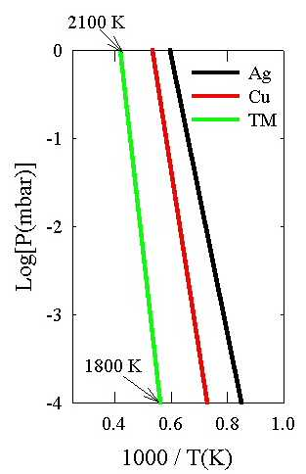
Vapor Pressure Curves
The vapor pressures of most materials follow an Arrhenius equation behavior: P_{VAP} = P₀ exp(-E_{A}/kT).
Most metals must be heated to temperatures well above 1000 K to achieve an appreciable vapor pressure.
For P_{VAP} = 10⁻⁴ mbar, the deposition rate is approximately 10 Å / sec.
Organic materials have much higher vapor pressures than metals.
Care must be taken as to what materials are placed in the vacuum environment.

Slide 13
Materials in Vacuum
Outgassing of materials can be the limiting factor in achieving good vacuum.
  It is usually best to use all stainless steel, aluminum, glass and copper.
  Elastomer gaskets and o-rings should be specifically manufactured for vacuum applications.
NEVER USE:
  Brass, zinc, or other alloys without first looking up the outgassing rate (should be less than 10⁻⁴ W/m²).
*O’Hanlon, Users Guide to Vacuum Technology, Wiley (1980).

Slide 14
Permeability and Other Gas Sources
A single viton seal on a flange, gate valve bonnet or pump inlet will limit the ultimate pressure to >10⁻⁹ mbar.
Unbaked systems will rarely reach better than 10⁻⁸ mbar.
Trapped volumes or virtual leaks will increase pump down time.
Microscopic air leaks can limit the ultimate pressure.
The use of a mass spectrometer on a regular basis will help to identify the nature of the gas source.

Slide 15
Pumping Speed
Pumps, valves, connections, and hoses all should have compatible pumping speeds.
Both pumpdown time and ultimate pressure can be limited by pumping speed.
Calculations of pumping speeds of fittings and flanges can be made from the formulae in O’Hanlon and the Ificon vacuum guide.

Slide 16
Rough Vacuum and Leaks
During roughing, a large leak can be detected by a hissing sound.
Slightly smaller leaks make a sound when liquid (acetone or isopropanol is squirted on them).
Once the thermocouple gauge starts to read a vacuum, and if it “gets stuck” at a pressure higher than normal, application of acetone to a leak will cause the reading to fluctuate.
Never switch on an ion gauge until you are confident the pressure is below 10⁻³ mbar.
Application of acetone to a leak will also register on the ion gauge in the pressure range of 10⁻⁴ to 10⁻⁸ mbar.
A He leak detector can be used below 10⁻⁴ mbar.

Slide 17
Vacuum System Schematic Symbols
Hand Operated Valve.
Gate Valve.
Pneumatic Gate Valve.
Leak Valve.
Butterfly Valve.
Pneumatic Butterfly.
Bellows.
Sorption Trap.
Vacuum Gauge.
Rotary Pump
Turbomolecular Pump.
Ti Sublimation Pump.
Ion Pump.
Cryo Pump.
*Inficon Instrumentation Catalog, 2000-2001

