Slide 1
Vacuum Calculation محاسبات در خلأ

Slide 2
BASIC CONCEPTS
Mean free path and Gas Flow Regimes ( Transition, Molecular and Viscous)
Gas flow rate and pumping speed
Desorption, Outgassing and Degassing
Leaks
Throughput Q=p*S
Pumping Speed
Residual Gas Composition
Vacuum Conductance, Series and Parallel
Electrical Analogy and Examples

Slide 3
Terminology
“Low vacuum” = High pressure
“High Vacuum” = Low pressure

Slide 4
تقسیم بندی نواحی خلأ

Slide 5
Common Vacuum Units
There are many varied units that are used to specify pressures
The Torr, the Bar and the Pascal are in common use...
.. but the Pascal is the SI recommended unit for pressure and so is the best choice for documentation
1 Atmospheric pressure is 760 mm Hg = 1 Bar = 10⁵ Pa
1 Torr = 1 mm Hg
1 Torr = 1/760 of an atmosphere = 132 Pa
1 milliTorr = 0.13Pa = 1 μmHg
1mbar = 1/1000 Atm = 0.76 Torr = 100Pa
1 Pa = 7.6 milliTorr = 7.6 μmHg

Slide 6
Pressure: Units of Measure
Pressure exerted by a column of fluid:
P ≡ F/A = mg/A = ρghA/A = ρgh ∝ h
1 Atm (mean sea level) = 760 Torr = 1013 mBar = 1.01x10⁵ Pa = 101.3 kPa = 14.7 psi = 34 ft. water
Average atmospheric pressure in SLC is about 635 Torr, 12.3 psi, 28.4 ft water…

Slide 7
“Kinds of Pressure”
Gauge Pressure: measured with respect to ambient.
Absolute pressure: measured with respect to vacuum
Car tires, basketballs, boilers, LN2 tanks, JFB/MEB compressed air supply…
Vacuum systems, cathode ray tubes, light bulbs, barometers

Slide 8
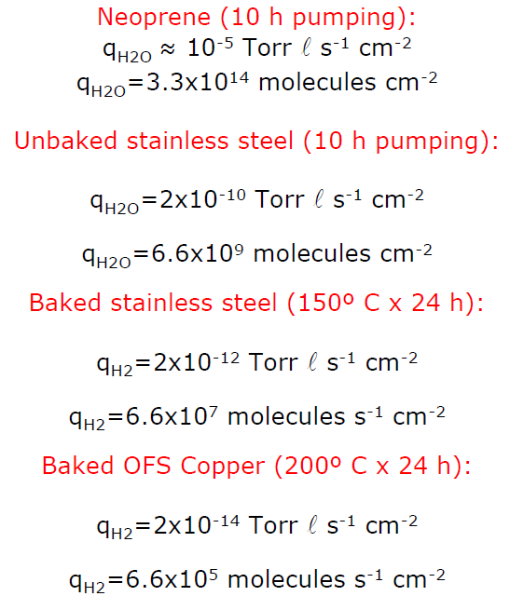
Desorption, outgassing, degassing
Gas molecules, (primarily water) are bound to the interior surfaces of the vacuum chamber and gradually desorb again under vacuum. The desorption rate of the metal and glass surfaces in the vacuum system produces a gas yield that decreases over time.
mbar
s⁻¹cm⁻²
mbar
s⁻¹cm⁻²
mbar
Q_{des}(t)=A*q_{des}(t)
mbar
Q_{des} | Desorption rate | [mbar l s⁻¹]
q_{des} | Desorption rate density or specific desorption rate | [mbar l s⁻¹ m⁻²]
A | Area | [m²]
Q_{des}
t

Slide 9
Leaks
Q_{L} describes the leak rate, i.e. a gas flow, which enters the vacuum system through leaks.
The leakage rate is defined as the pressure rise over time in a given volume:
Q_{L} | Leak rate | [mbar l s⁻¹]
Δp | Pressure change during measurement period | [mbar]
V | Volume of the system | [l]
Δt | Measurement period | [s]

Slide 10
Pumping Speed
Is the volume of gas flowing through the cross section of the inlet port of a vacuum pump.
The pump’s maximum achievable pumping speed is always referred to as its rate pumping speed. Determination of the pumping speed is described in base standard ISO 21360-1.
$s=\frac{dV}{dt}$ [l/s]
Nitrogen
The pumping speed depends on the system pressure and gas type
Argon
All pumps have both high
and low applicable
pressure limit

Slide 11
Gas flow rate and pumping speed
In a vacuum system (to the 1° order) the total gas load is the sum of several contributions.
The main important (for our typical applications) are:
Desorption or outgassing ( Q_{des});
Leaks (Real or Virtual , Q_{L})
Desorption or Outgassing (Q_{des})
SYSTEM
Leaks (Q_{L})
P(t)
Q_{pV}
Q_{tot} = Q_{des}+ Q_{L}
Pumping speed (S)
PUMP
The final pressure in the system is given by the equilibrium between the total gas load (Q_{tot}) and the gas flowing into the pump (pS).
The pressure p(t) can be obtained solving this equation:

Slide 12
ِفرمولبندی های خلأ
PV = nRT; $(P+\frac{A}{V^{2}}$)(V-b)=nRT; M= $N_{A}$m ; $ρ=nm$
ناشی از نیروهای جاذبه بین مولکولی$\frac{A}{V^{2}}$
نشانه حجمی است ناشی از ابعاد مولکولهاست که از حجم محفظه کم میشود b
$λ=\frac{1}{2^{1/2}πnξ^{2}}$ =$\frac{KT}{2^{1/2}πξ^{2}P}$ مسیر آزاد میانگین
محتملترین، میانگین، و جذرمتوسط سرعت
$v_{p}$=($\frac{2KT}{m})^{1/2}$; $v_{av}$=$\frac{2}{√π}$($\frac{2KT}{m})^{1/2}$; $v_{r}$=($\frac{3}{2})^{1/2}$($\frac{2KT}{m})^{1/2}$
سرعت صوت در گازهای تک، دو، و چند اتمی
$v_{s}$=($\frac{ᵞP}{ρ})^{1/2}$; $ᵞ$ = $\frac{C_{P}}{C_{V}}$ : $\frac{5}{3} ;$ $\frac{7}{5};\frac{8}{6}$:1.66;1.40;1.33
$η=\frac{1}{3}nmv_{av}$ $λ$= $\frac{2}{3πξ^{2}}$($\frac{mKT}{π})^{1/2}$ چسبندگی
σ = $π$ $ξ^{2}$= $\frac{0.998}{η}$($\frac{mKT}{π})^{1/2}$ سطح مقطع برخورد بین مولکولی

Slide 13
زمان رسیدن به خلأ (Pump down Time)
زمان مورد نیاز جهت پمپاژ از فشار اتمسفر به فشار مورد استفاده سیستم با حجم ثابت و ظرفیت کلی پمپاژ متناسب با حجم گاز آزاد داخل سیستم و دفع گاز از جداره های سیستم می باشد.
$t=−$V$\int_{P_{1}}^{P_{2}}{\frac{1}{S_{e}P}dp+\int{\frac{Q_{g}}{S_{e}}dt}}$
${\text{دفع گاز از جداره های سیستم}Q}_{g}$

Slide 14
محاسبه زمان تخلیه
(760-${10}^{−3}$ torr) پمپ مکانیکی محدوده فشاری از
$$t=−\frac{V}{S_{e}}\int_{P_{1}}^{P_{2}}{\frac{1}{P−P_{u}}dp}$$
فشار نهایی پمپ $P_{u}$
فشارهای پایین: در این محدوده دفع گاز از جداره های سیستم. اهمیت می یابد. بنابراین لازم است تا تغییرات زمانی دفع گاز از جداره ها در نظر گرفته شود. در اینصورت میتوان میزان تخلیه گاز از سیستم را برابر با میزان دفع گاز از جداره ها در نظر گرفت:
$Q=S_{e}$P=$\sum{ }K_{i}A_{i}$
$K_{h}=K_{u}$+$K_{1}t^{−ᵞ}$; $P_{u}=\frac{K_{u}}{S_{e}}; P_{1}=\frac{K_{1}}{S_{e}}$

Slide 15
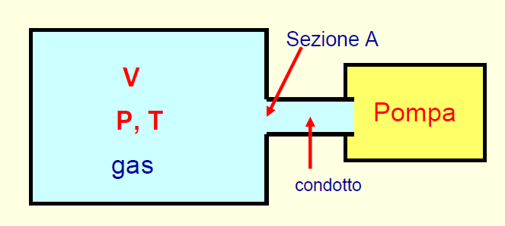
Vacuum Conductance
Gases moving through elements (pipes, tubes, vessels, and orifices) in a vacuum system encounter resistance to their motion. We can define the impedance of a tube as:
Section A
P₁
P₂
Pump
Pipe
Impedance
Z=( P₁-P₂ )/ Q
C= 1/Z=Q/P₁-P₂
Defines the pressure
drop in a pipe
Conductance is an abstract concept used to describe the behavior of gas in a vacuum system.
• Conductance is specific to a particular geometrical configuration.
• Conductance is specific to the actual gas species and temperature.
The Condutance is the capability to let through a particular gas volume in a known time
Notes:
Prima di introdurla dare un esempio semplice. Manca la definizione di conduttanza o impedenza.
Consideriamo un recipiente ideale a pareti rigide di volume V
contenente N molecole di gas alla temperatura T ed alla pressione P
􀂄 Il recipiente è collegato ad una pompa da vuoto tramite un condotto di
sezione A (A è la sezione del foro che collega il recipiente al condotto).
􀂄 All’istante t nel recipiente ci sono N molecole alla pressione P
􀂄 All’istante t+dt nel recipiente ci sono N′ molecole alla pressione P′
La conduttanza è la capacità di un’apertura di lasciar fluire un determinato volume di gas in un’unità di tempo

Slide 16
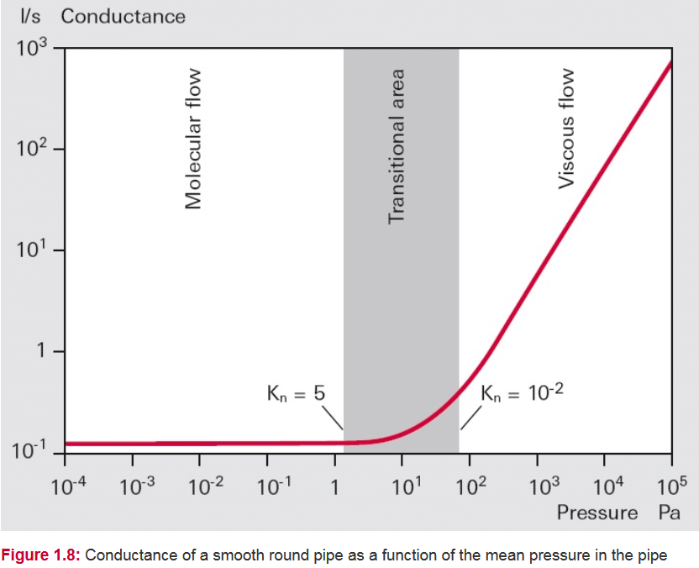
Conductance Properties
The conductance of pipes and pipe bends will differ in the various flow regimes.
In viscous flow they are proportional to the mean pressure p and in molecular flow they are independent of pressure. Knudsen flow represents a transition between the two types of flow, and the conductivities vary with the Knudsen number.
10⁻² mbar
1 mbar

Slide 17
Example:
Conductance in Molecular Flow of a Long Round Tube
Under molecular flow conditions doubling the pipe diameter increases the conductance eight times. The conductance is INVERSELY related to the pipe length.

Slide 18
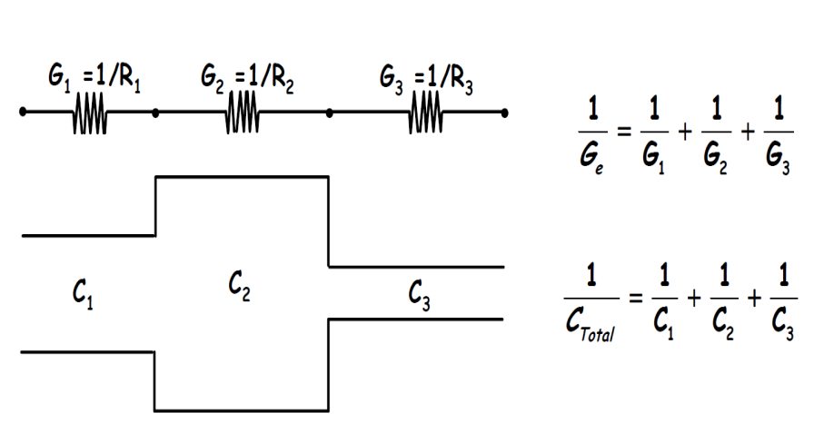
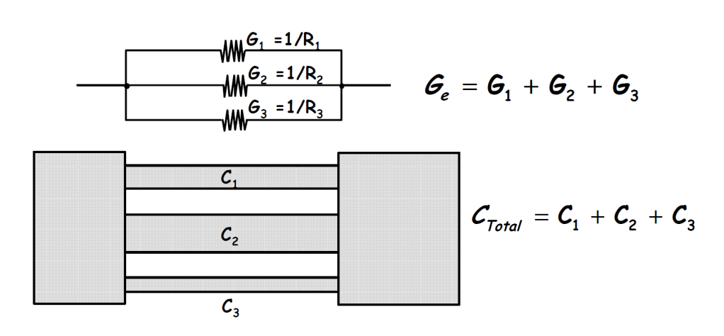
Electrical Analogy of a Vacuum System (1/2)
A vacuum system can be analized/designed using an equivalent electrical model.
In this model:
1-pressures at a given point is the voltage
2-gas flow rate Q is the current
3-the conductances are electrical resistors
4-the pumping system are voltage generator
5- leacks as resistors that connect a given point to the mass.
I=ΔV/R= I=ΔV*G ⇒ Q=ΔP*C
Conductances
in Series
Conductances
in Parallel

Slide 19
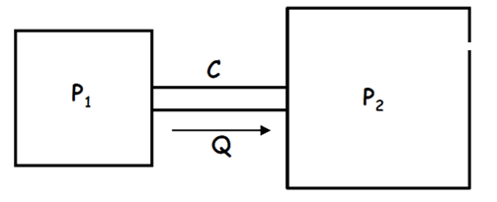
Electrical Analogy of a Vacuum System (2/2)
leaks
f.e.m = electromotive force pump
Z = Pipe Impedance
Z_{c} = Leaks Impedance
Z_{p} , Z_{s} = Pump’s Impedance
C = Volume of Vacuum Chamber
= 1/Z
Pump
Vacuum Chamber (V)
Z
C
f.e.m
Z_{c}
Z_{p}
Z_{s}

