Slide 1

Virology

Slide 2

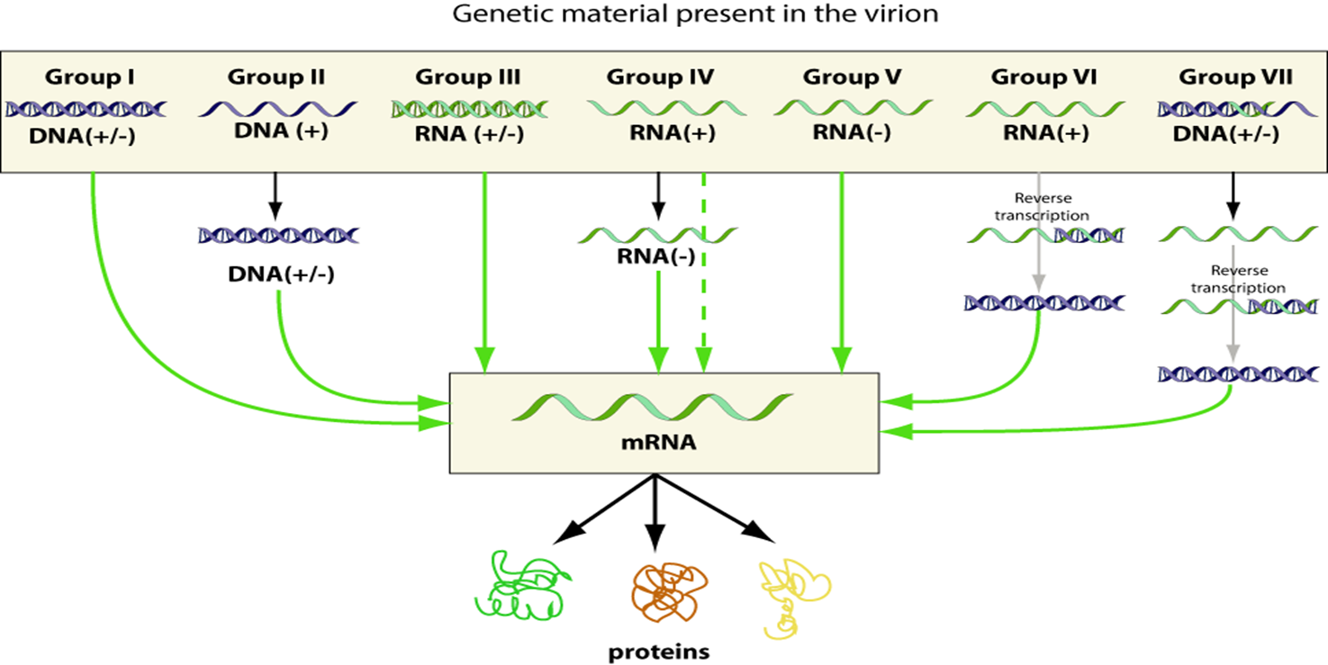

Slide 3
Group I: Double-stranded DNA viruses
I: dsDNA viruses (e.g. Adenoviruses, Herpesviruses, Poxviruses)
These types of viruses must enter the host nucleus before they are able to replicate. Furthermore, these viruses require host cell polymerases to replicate the viral genome and, hence, are highly dependent on the cell cycle. Proper infection and production of progeny requires that the cell be in replication, as it is during replication that the cell's polymerases are active. The virus may induce the cell to forcefully undergo cell division, which may lead to transformation of the cell and, ultimately, cancer. Examples include Herpesviridae, Adenoviridae, and Papillomaviridae.
There is only one well-studied example in which a class 1 virus is not replicating within the nucleus: the Poxvirus family, a highly pathogenic virus that infects vertebrates and includes the smallpox virus.

Slide 4
Genome organization within this group varies considerably. Some have circular genomes while others have linear genomes. The genomes in this group vary considerably from ~10 kilobases to over 2.5 megabases in length.
All dsDNA viruses have non-segmented genome.

Slide 5
Group II: Single-stranded DNA viruses
ssDNA virus
Viruses in this category e.g. Anelloviridae, Circoviridae, and Parvoviridae. Most of them have circular genomes (the parvoviruses are the only known exception). Eukaryote-infecting viruses replicate mostly within the nucleus - usually via a rolling circle mechanism.
All viruses in this group require formation of a replicative form—a double stranded DNA intermediate—for genome replication. This is normally created from the viral DNA with the assistance of the host's own DNA polymerase.
All known eukaryotic ssDNA viruses also form non-enveloped icosahedral capsids.
The size of genome is between 2-9 Kb.

Slide 6
Group III: Double-stranded RNA viruses
dsRNA virus
As with most RNA viruses, this class replicates in the "Core" capsid that is in cytoplasm, not having to use the host replication polymerases to as much a degree as DNA viruses. This family is also not as well-studied as the rest and includes 2 major families, the Reoviridae and Birnaviridae. Replication is monocistronic and includes individual, segmented genomes, meaning that each of the genes codes for only one protein, unlike other viruses that exhibit more complex translation.
Most of them have segmented genome. All dsRNA viruses have icosahedral capsid.

Slide 7
The ssRNA viruses belong to Class IV or V of the Baltimore classification. They could be grouped into positive sense or negative sense according to the sense of polarity of RNA. The single stranded RNA is the common feature of these viruses. The replication of viruses happens in the cytoplasm or nucleus (for segmented class V viruses). Class IV and V ssRNA viruses do not depend as heavily as DNA viruses on the cell cycle.
Group IV: Single-stranded RNA viruses - Positive-sense
positive-sense ssRNA virus
The positive-sense RNA viruses and indeed all RNA defined as positive-sense can be directly accessed by the host ribosomes immediately to form proteins. These can be divided into two groups, both of which reproduce in the cytoplasm:
Viruses with polycistronic mRNA where the genome RNA forms the mRNA and is translated into a polyprotein product that is subsequently cleaved to form the mature proteins. This means that the gene can utilize a few methods in which to produce proteins from the same strand of RNA, all in the sake of reducing the size of its gene.
Viruses with complex transcription, for which subgenomic mRNAs, ribosomal frameshifting, and proteolytic processing of polyproteins may be used. All of which are different mechanisms with which to produce proteins from the same strand of RNA.
Examples of this class include the families Astroviridae, Caliciviridae, Coronaviridae, Flaviviridae, Picornaviridae, Arteriviridae, and Togaviridae.

Slide 8
The positive-sense viral RNA genome can serve as messenger RNA and can be translated into protein in the host cell. Positive-sense ssRNA viruses belong to Group IV in the Baltimore classification. Positive-sense RNA viruses account for a large fraction of known viruses, including many pathogens such as the hepacivirus C, West Nile virus, dengue virus, SARS and MERS coronaviruses, and SARS-CoV-2 as well as less clinically serious pathogens such as the rhinoviruses that cause the common cold.
The genome of a positive-sense ssRNA virus usually contains relatively few genes, usually between three and ten, including an RNA dependent RNA polymerase. Coronaviruses have the largest known RNA genomes, up to 32 kilobases in length

