Slide 1
Virology
جلسه هفتم

Slide 2
Types of Mutations
Mutations can be classified according to the kind of change they produce in the viral genome or the kind of change they produce in the properties of the virus or the infection it causes. The former pertains to change in the viral genotype, the latter in the viral phenotype. Phenotypic change may be evidenced by a change in a physical characteristic of the virion, by a change in a replicative characteristic seen during infection in cell culture, or by a change in a pathogenetic property in an infected animal.

Slide 3
Genotypic Classification of Mutants
The most common mutations are single nucleotide substitutions-- these are called point mutations. Mutations may also involve deletions or insertions of single nucleotides or small or large blocks of nucleotides. The phenotypic expression of a mutation may be reversed not only by a back-mutation in the affected nucleotide(s) but also by a suppresser mutation occurring elsewhere in the same gene, or even in a different gene, which leads to the reappearance of the wild-type phenotype. For example, some temperature-sensitive mutants of influenza virus developed as potential attenuated virus vaccines have reverted to virulence because of independent suppresser mutations in apparently unrelated genes.

Slide 4
Phenotypic Classification of Mutants
The phenotypic expression of a mutation may be seen in various ways: relative to the wild type a mutant may produce a different type of plaque in a cell monolayer (plaque mutants),
may become resistant to neutralization by antibody raised against the wild type (antibody escape mutants), or may exhibit any of many other variant properties. Mutations affecting antigenic determinants on virion surface proteins are strongly favored when viruses replicate in the presence of an antibody.
Conditional lethal mutants cannot grow under certain (restrictive) experimental conditions but can replicate under other (permissive) conditions. The conditional lethal mutants studied most commonly are those whose replication is blocked in certain host cells (host range mutants) or at certain defined temperatures (temperature-sensitive mutants, cold-adapted mutants). With the latter, the selective condition used is the temperature of incubation of infected cells. Mutation results in a structurally abnormal protein which--although functional at the permissive temperature--cannot maintain its structural integrity and functional conformation ~hen the temperature is changed by a few degrees.

Slide 5
Mutation Rates
Replication of cellular DNA in eukaryotic cells is subject to proofreading, an error-correction mechanism involving exonuclease activity. Because the replication of those DNA viruses that replicate in the nucleus is subject to the same proofreading, their mutation rates are probably similar to that of host cell DNA. Errors occur at a rate of 10 -1~ and 10 -11 per incorporated nucleotide (i.e., per nucleotide per replication cycle).
Because of the absence of a cellular proofreading mechanism for RNA, error rates during the replication of viral RNAs are much higher than those of viral DNA. This rate of nucleotide substitution is about one million times higher than the average rate in eukaryotic DNA.

Slide 6
Genetic Recombination between Viruses
When two different viruses simultaneously infect the same cell, genetic recombination may occur between the nucleic acid molecules during or after their synthesis; this may take the form of intramolecular recombination, reassortment, or reactivation (the latter if one of the viruses had been inactivated).
Intramolecular Recombination
Intramolecular recombination involves the exchange of nucleotide sequences between differentmbut usually closely relatedmviruses during replication (Figure 4.3A).
It occurs with all double-stranded DNA viruses, presumably because of template switching by the polymerase. Intramolecular recombination also occurs among RNA viruses.
Recombination between viral and cellular genetic information has been established and, for at least some viruses, is also important in virus evolution.

Slide 7
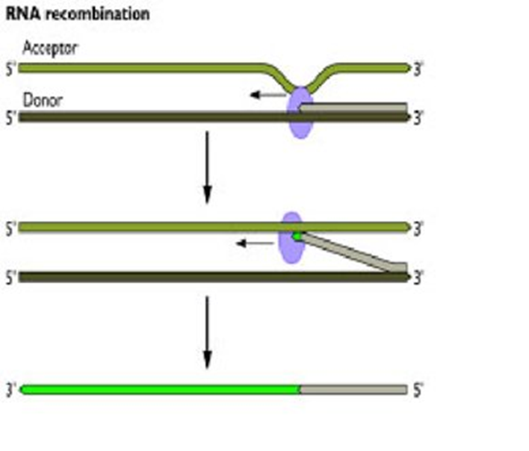

Slide 8
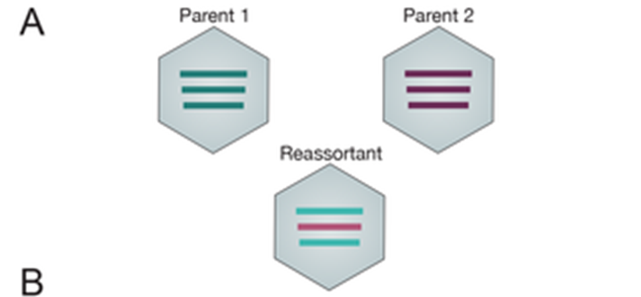
Reassortment
Reassortment is a form of genetic recombination observed in RNA viruses with segmented genomes, whether these be single or double stranded and whether these involve few or many segments. Reassortment has been documented in families with 2 (Arenaviridae and Birnaviridae), 3 (Bunyaviridae), 6, 7, or 8 (Orthomyxoviridae), or 10, 11, or 12 (family Reoviridae) genome segments. In a cell infected with two related viruses within each of these families, an exchange of segments may occur, with the production of viable and stable reassortants.

Slide 9
Reactivation
The term multiplicity reactivation is applied to the production of infectious virus by a cell infected with two or more virus particles of the same strain, each of which had suffered a lethal mutation in a different gene. Multiplicity reactivation could theoretically lead to the emergence
of infectious virus if animals were inoculated with vaccines produced by UV-irradiation or chemical mutagenesis; these methods are therefore not used for vaccine production. Cross-reactivation, genome rescue, and DNA fragment rescue are terms used to describe genetic recombination between infectious and inactivated viruses of related but distinguishable genotypes (or a DNA fragment from such a virus).

