Slide 1
Virology
جلسه یازدهم

Slide 2
Adenoviridae
From Greek adenos (gland), for site of first isolation, adenoids
VIRION
Naked icosahedral capsid, Diameter 70–90 nm. Knobbed fibers protruding from each of 12 vertices.
VIRUSES AND HOSTS
Fifty human serotypes in six subgroups (A through G). Other adenoviruses in cattle, mice, birds, etc.
DISEASES
Respiratory syndromes including pneumonia, but not common colds. Eye and gastrointestinal infections

Slide 3
This family contains the following genera:
Genus Atadenovirus; type species: Ovine atadenovirus D
Genus Aviadenovirus; type species: Fowl aviadenovirus A
Genus Ichtadenovirus; type species: Sturgeon ichtadenovirus A
Genus Mastadenovirus (including all human adenoviruses); type species: Human mastadenovirus C
Genus Siadenovirus; type species: Frog siadenovirus A
In humans, there are 57 accepted human adenovirus types (HAdV-1 to 57) in seven species (Human adenovirus A to G)

Slide 4
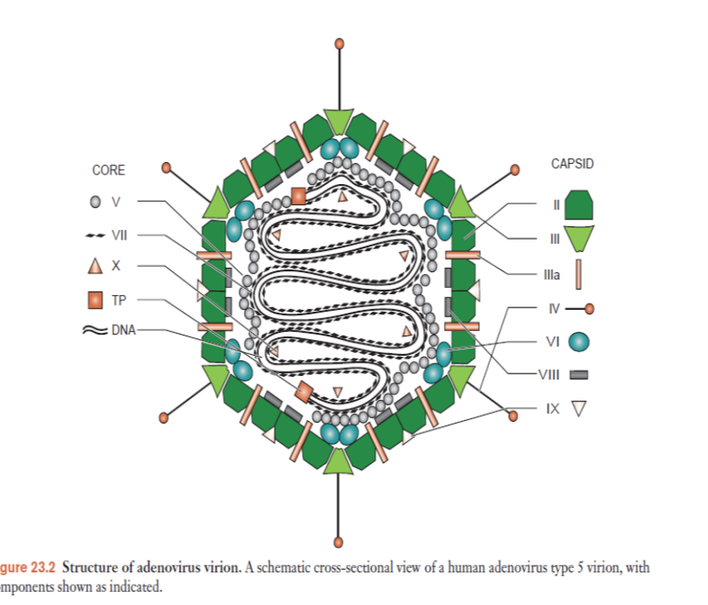
Structure[Adenoviruses represent the largest known nonenveloped viruses. They are able to be transported through the endosome (i.e., envelope fusion is not necessary). The virion also has a unique "spike" or fiber associated with each penton base of the capsid (see picture below) that aids in attachment to the host cell via the receptor on the surface of the host cell.

Slide 5
The 30- to 36-kb linear, double-stranded viral DNA. A 55-kDa virus-coded terminal protein is covalently linked via a serine residue to each of the 5' ends of the viral DNA. The viral DNA contains inverted terminal repeat sequences of approximately 100 bp. This means that the first 100 nt at the 5' and 3' ends of each DNA strand are complementary and can base-pair, allowing single DNA strands to circularize, forming a short panhandle end. Both the terminal protein and the inverted terminal repeats are involved in viral DNA replication (see below).

Slide 6
Adenoviruses attach to specific cellular receptors via the knob of the fiber protein.
CAR is a cell surface protein of unknown function. Adenoviruses types 2 and 5 also utilize certain cell surface integrin proteins, as secondary receptors.
Binding to integrins leads to the migration of virus-receptor complexes into endosomes. After which the virion escapes to the cytosol in a process dependent on the acidic pH of the endosome. Virus particles are transported toward the nucleus using microtubules. They localize at nuclear pores where they are disassembled in a sequential manner, and the DNA is released into the nucleus.

Slide 7
Transcription units can be divided into three classes, depending on the timing of their use during the infectious cycle.
The six early transcription units are named E1A, E1B, E2A, E2B, E3, and E4.
The two intermediate transcription units are named IX and IVa2.
There is only one late transcription unit, with a single promoter but five different polyadenylation sites. This gives rise to five families of late mRNAs, named L1 through L5.
E1A is the first viral gene to be transcribed. The E1A promoter, located near the left end of the genome. Viruses that contain mutations in E1A genes make strongly reduced amounts of other early gene products, and therefore little DNA or progeny virions. The E1A proteins help provide these required cellular proteins by inducing non-dividing cells to enter the S, or DNA synthesis, phase of the cell cycle.

Slide 8
E1B proteins suppress E1A-induced apoptosis and target key proteins for degradation, allowing virus replication to proceed.
E1B proteins protect infected cells from both p53-dependent and p53-independent apoptosis, reversing activities stimulated by E1A proteins. This allows the cell to survive long enough to produce high levels of progeny adenovirus virions before eventually succumbing to the effects of virus infection.
Replication of DNA
Once E1A has induced the cell to enter S phase and the early viral gene products have accumulated, viral DNA replication begins. Three essential proteins made by E2 genes carry out viral DNA replication. A single-stranded DNA binding protein (ssDBP) is produced from the E2A region, while both a viral DNA polymerase and an 80-kDa preterminal protein (pTP) are encoded by E2B.
DNA replication can begin at either end of the linear DNA molecule. The replication origins, including the first 50 nt of each inverted terminal repeat, contain binding sites for a complex between the adenovirus DNA polymerase and preterminal protein.
The first step in DNA replication is unusual. Instead of an RNA primer (used by cells and by most DNA viruses) or a DNA primer (used by parvoviruses), adenoviruses use the preterminal protein as a primer for replication.

Slide 11
Two viral proteins have been implicated in cell killing and virus release. One is the E3 11.6-kDa “death protein”. Although it is nominally an early protein, the protein is expressed at high levels during the late phase when its mRNA is made using the major late promoter and an E3 polyadenylation site.
The E4 protein also can induce cell death, via a p53-independent mechanism. When expressed alone, E4 kills a wide range of cancer cells, but it has little effect on normal human cells.

