Slide 1
جلسه دهم
Virology

Slide 2
Herpesviridae
Order: Herpesvirales
Family: Herpesviridae
Subfamily
Alphaherpesvirinae
Betaherpesvirinae
Gammaherpesvirinae
Herpesviridae: 3 subfamilies, 13 genera, 107 species
This family includes hundreds of viruses of mammals, birds, and reptiles.

Slide 3
Human herpesviruses are best known as the cause of discomfort from recurring “cold sores”, lesions of the mucosa of the mouth and lips. Genital herpes lesions are a common sexually transmitted disease, and chickenpox is a common childhood disease that can be serious particularly when people are first exposed as adults. These three relatively mild but often annoying human diseases are caused, respectively, by herpes simplex virus types 1 and 2, and by varicella-zoster virus. However, under conditions of reduced immune response found in newborns, transplant recipients, and AIDS victims herpesviruses can cause serious and often fatal disease, including encephalitis, pneumonia, and hepatitis.
One of the most intriguing characteristics of herpesviruses is their ability to establish latent infections. After an initial infection, viral DNA is harbored in a latent state in neurons, B or T lymphocytes, or other cell types. Latently infected individuals can remain without symptoms for months or years, or even their entire life.
Reactivation of latent virus can lead to recurrent disease, such as repeated outbreaks of labial or genital herpes, or herpes zoster (“shingles”), a localized rash that can occur years after the initial chickenpox infection. People whose immune systems are impaired can suffer reactivation of cytomegalovirus or Kaposi’s sarcoma virus with dire results. The mechanisms by which herpesviruses establish latent infections and reactivate are presently under intense study.

Slide 4
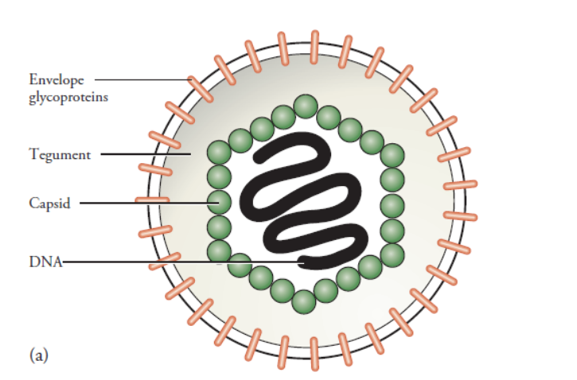
The icosahedral capsid is enclosed in an envelope along with tegument proteins
The herpes simplex virus genome is wrapped in a bilayered capsid. Another capsid protein, VP26, is located at the tips of the capsomers. The capsid is enclosed in an envelope that contains at least 10 different glycoproteins (gB through gM) and several other non-glycosylated membrane proteins. Unlike most enveloped viruses, there is a large amorphous mass between the capsid and the envelope, called the tegument, which contains about 14 virus-coded proteins. Tegument proteins are introduced into the cell upon infection by herpesviruses, and some of themcarry out crucial functions in the virus growth cycle.

Slide 5
HSV-1 genome organization organization
HSV-1 is one of the most-studied herpesviruses; we shall look at its genome organization and then at its replication. The genome consists of two unique sequences each flanked by repeat sequences (Figure 11.4(a)). The unique sequences are not of equal length: the longer is designated UL and the shorter is designated US. The HSV-1 genome encodes at least 74 proteins plus some RNAs that are not translated (Figure 11.4(b)). Both strands of the DNA are used for coding. The inverted repeats contain some genes, so the genome contains two copies of these genes, one in each strand.

Slide 6
The sequence of events at the cell surface usually involves the HSV-1 virion binding initially to heparin sulphate, and then to the main receptor. The latter can be one of several types of cell surface molecule including some nectins, which are cell adhesion molecules. The virion envelope then fuses with the plasma membran. Infection may also occur by endocytosis, followed by fusion between the virion envelope and the endosome membrane. The nucleocapsid and the tegument proteins are released into the cytoplasm and the nucleocapsid must then be transported to the nucleus, where virus replication takes place. The virus DNA is released into the nucleus, where the linear molecule is converted into a covalently closed circular molecule, which becomes associated with cell histones. Studies with antibodies specific for tegument proteins have provided evidence that these proteins are transported to several sites in the cell. At these sites tegument proteins play a variety of roles, including the down-regulation of host DNA, RNA and protein synthesis. One tegument protein known as virion host shutoff (vhs) protein degrades cell mRNA. Other tegument proteins are involved in the activation of virus genes, in particular the major tegument protein, VP16, which is transported to the nucleus, where it becomes associated with the virus DNA.
.

Slide 7
Transcription and translation
Herpesvirus genes are expressed in three phases: immediate early (IE), early (E) and late (L). Some authors refer to these phases by the Greek letters α, β and γ. There are introns in a few of the HSV-1 genes, mainly in the IE genes. The IE genes are activated by VP16. It was noted above that VP16 from infecting virions associates with the virus DNA. It does this by binding to a complex of cell proteins including Oct-1, which binds to the sequence TAATGARAT present in the promoter of each of the IE genes. VP16 then acts as a transcription factor to recruit the host RNA polymerase II and associated initiation components to each IE gene. Some of the E proteins have roles in virus DNA replication. Most of the L proteins are the virus structural proteins.

Slide 8
The virus DNA is replicated by E proteins, seven of which are essential for the process. Copies of an origin-binding protein bind at one of three ori sites in the virus DNA. The protein has a helicase activity, causing the double helix to unwind at that site, and it has an affinity for the resulting single strands of DNA. The double helix is prevented from re-forming by the binding of copies of a ssDNA-binding protein.
The ori site is then bound by a complex of three proteins, which act as a helicase, further unwinding the double helix to form a replication fork. On one of the strands a complex of the same three proteins (now acting as a primase) synthesizes a short sequence of RNA complementary to the DNA. This RNA acts as a primer, and the DNA polymerase complexed with a polymerase processivity factor starts to synthesize the leading strand of DNA. On the other genome strand primases synthesize short RNAs, which are the primers for the synthesis of the Okazaki fragments of the lagging strand of DNA.

Slide 9
Assembly and exit of virions from the cell
The virus envelope glycoproteins are synthesized in the rough endoplasmic reticulum and are transported to the Golgi complex. The other structural proteins, such as VP5, accumulate in the nuclear replication compartments, where procapsids are constructed. A procapsid is more rounded than a mature capsid and its structural integrity is maintained by the incorporation of scaffolding proteins. Before or during DNA packaging the scaffolding proteins are removed by a virus-encoded protease.
The DNA enters the procapsid via a portal at one of the vertices of the icosahedron. Once the nucleocapsid has been constructed it must acquire its tegument and envelope and then the resulting virion must be released from the cell; these are complex processes and many of the details are still unclear.
Although the virion envelopes are derived from membranes within the cell, virus glycoproteins are also expressed at the cell surface. These glycoproteins can cause fusion between infected cells and non-infected cells, resulting in the formation of giant cells known as syncytia, which can be observed both in infected cell cultures and in HSV lesions. Infected cell cultures are normally destroyed 18–24 hours after inoculation.

