Slide 1
ژنتیک باکتری ها جلسه چهارم (سوم مجازی)

Slide 2
جزئیات رونوشت برداری
Binding
Promoter recognition
Isomerization
Closed complex
Open complex
Active-site channel
Inition
Elongation phase

Slide 5
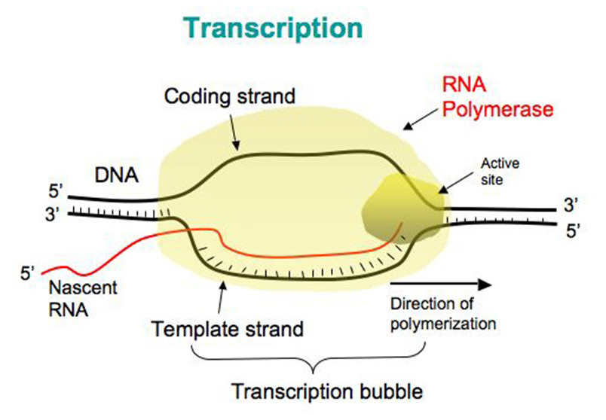
Elongation
Transcription elongation bubble
RNA exit channel

Slide 7
Termination of transcription
Factor independent transcription termination
Factor dependent transcription termination

Slide 8
Factor independent transcription termination

Slide 9
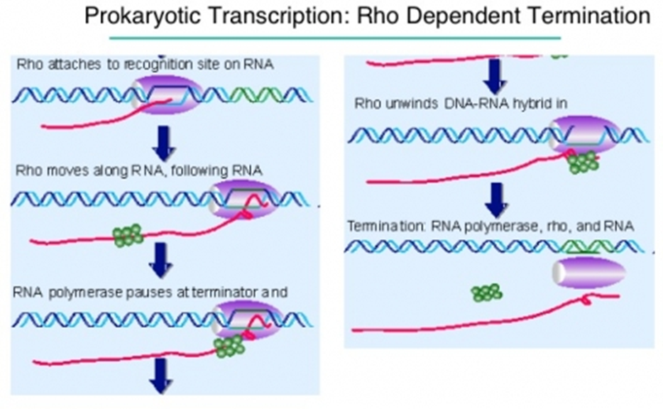
Factor dependent transcription termination
Rho (ρ)
Tau (τ)
NusA
ρ-dependent termination site
Rho utilization site (rut site)
Rho sensitive pause site

